Slide 1
Chapter 8 C Characters and Strings
C How to Program, 8/e, GE

Slide 2
8.1 Introduction
This chapter introduces the C Standard Library functions that facilitate string and character processing.
The functions enable programs to process characters, strings, lines of text and blocks of memory.
The chapter discusses the techniques used to develop editors, word processors, page-layout software, computerized typesetting systems and other kinds of text-processing software.
The text manipulations performed by formatted input/output functions like printf and scanf can be implemented using the functions discussed in this chapter.

Slide 3
8.2 Fundamentals of Strings and Characters
Characters are the fundamental building blocks of source programs.
Every program is composed of a sequence of characters that—when grouped together meaningfully—is interpreted by the computer as a series of instructions used to accomplish a task.
A program may contain character constants.
A character constant is an int value represented as a character in single quotes.
The value of a character constant is the integer value of the character in the machine’s character set.

Slide 4
8.2 Fundamentals of Strings and Characters (Cont.)
For example, 'z' represents the integer value of z, and '\n’ represents the integer value of newline (122 and 10 in ASCII, respectively).
A string is a series of characters treated as a single unit.
A string may include letters, digits and various special characters such as +, -, *, / and $.
String literals, or string constants, in C are written in double quotation marks.

Slide 5
8.2 Fundamentals of Strings and Characters (Cont.)
A string in C is an array of characters ending in the null character ('\0').
A string is accessed via a pointer to the first character in the string.
The value of a string is the address of its first character.
Thus, in C, it’s appropriate to say that a string is a pointer—in fact, a pointer to the string’s first character.
In this sense, strings are like arrays, because an array is also a pointer to its first element.
A character array or a variable of type char * can be initialized with a string in a definition.

Slide 6
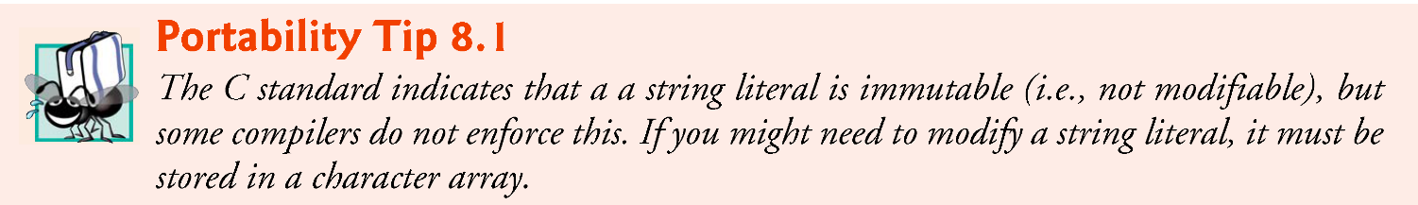
8.2 Fundamentals of Strings and Characters (Cont.)
The definitions:
char color[] = "blue"; const char *colorPtr = "blue";
each initialize a variable to the string "blue".
The first definition creates a 5-element array color containing the characters 'b', 'l', 'u', 'e' and '\0'.
The second definition creates pointer variable colorPtr that points to the string "blue" somewhere in memory.

Slide 7
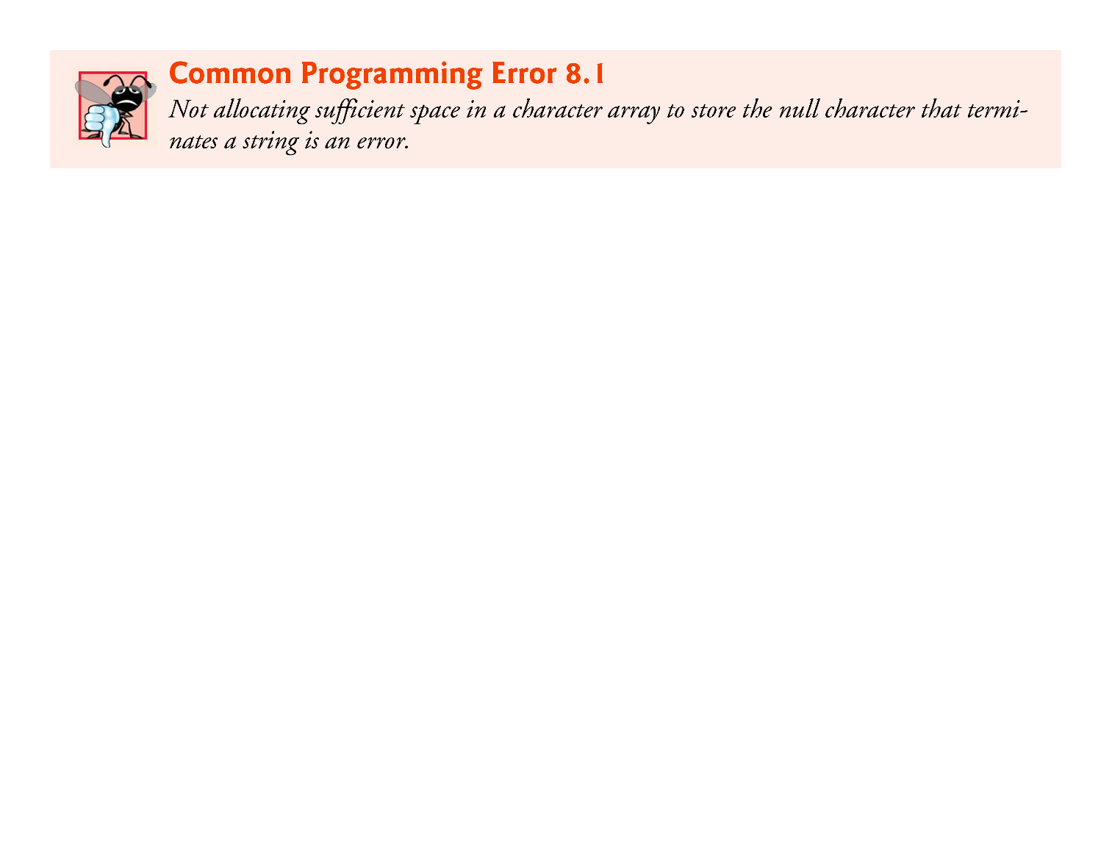
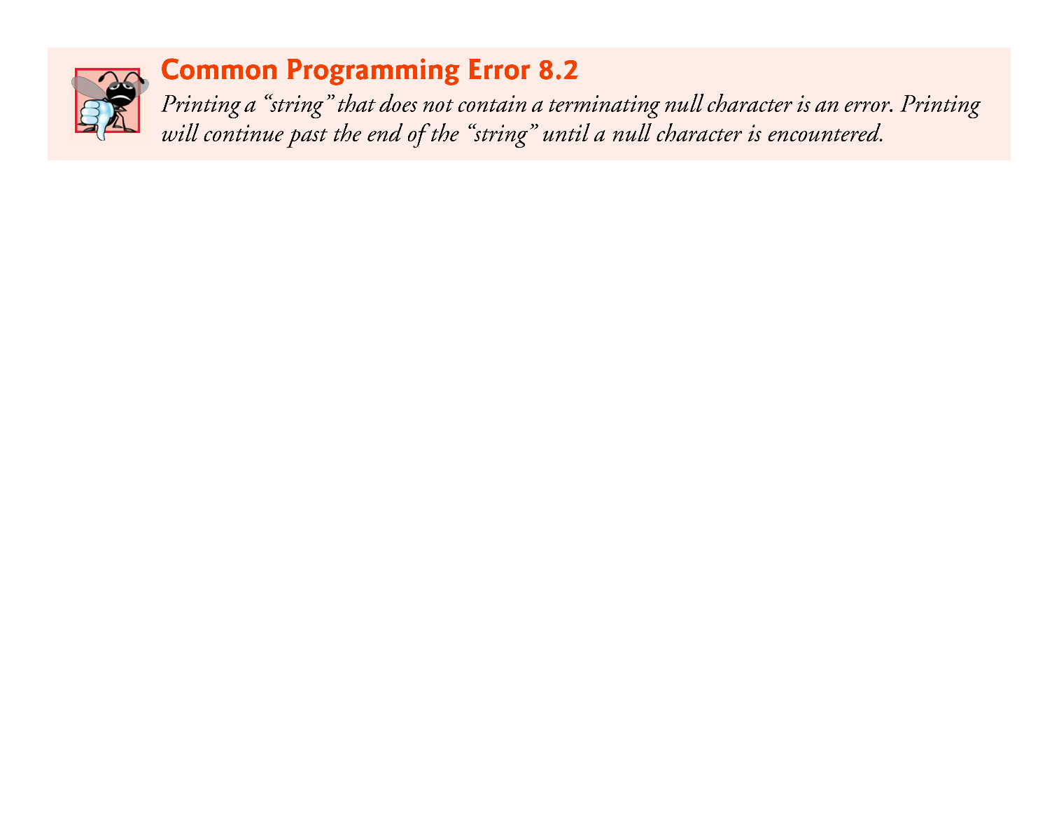
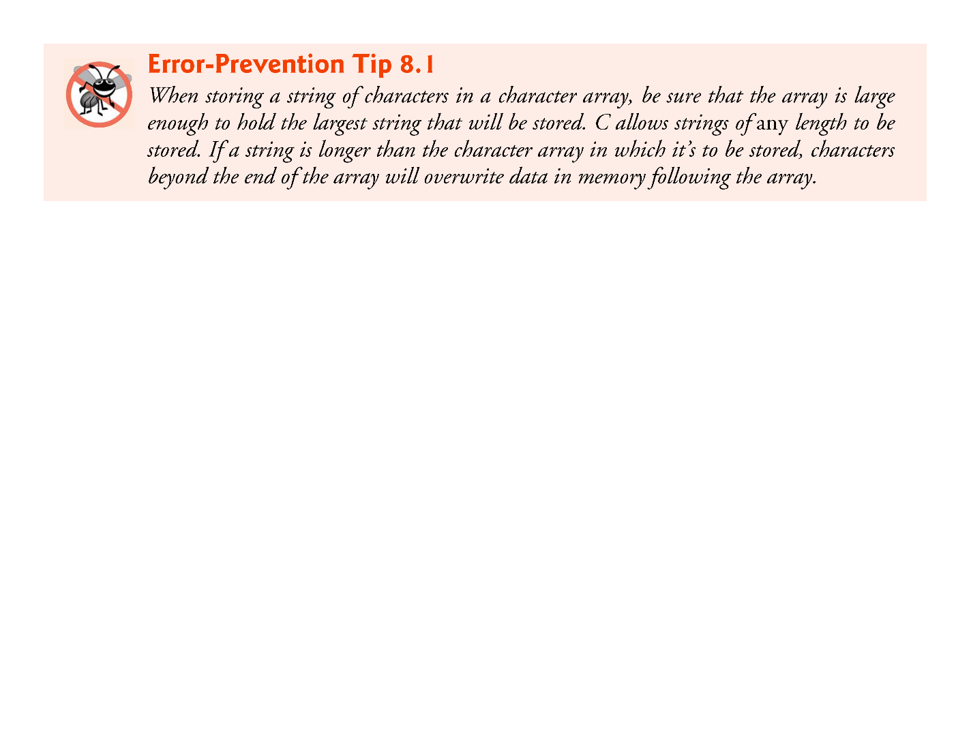
8.2 Fundamentals of Strings and Characters (Cont.)
The preceding array definition could also have been written
char color[] = {'b', 'l', 'u', 'e', '\0'};
When defining a character array to contain a string, the array must be large enough to store the string and its terminating null character.
The preceding definition automatically determines the size of the array based on the number of initializers in the initializer list.

Slide 8
8.2 Fundamentals of Strings and Characters (Cont.)
A string can be stored in an array using scanf.
For example, the following statement stores a string in character array word[20]:
scanf("%s", word);
The string entered by the user is stored in word.
Variable word is:
an array,
which is, of course, a pointer,
so the & is not needed with argument word.

Slide 9
8.2 Fundamentals of Strings and Characters (Cont.)
scanf will read characters until a space, tab, newline or end-of-file indicator is encountered.
So, it’s possible that, without the field width 19 in the conversion specifier %19s, the user input could exceed 19 characters and that your program might crash!
For this reason, you should always use a field width when using scanf to read into a char array.
The field width 19 in the preceding statement ensures that scanf reads a maximum of 19 characters and saves the last character for the string’s terminating null character.

Slide 10
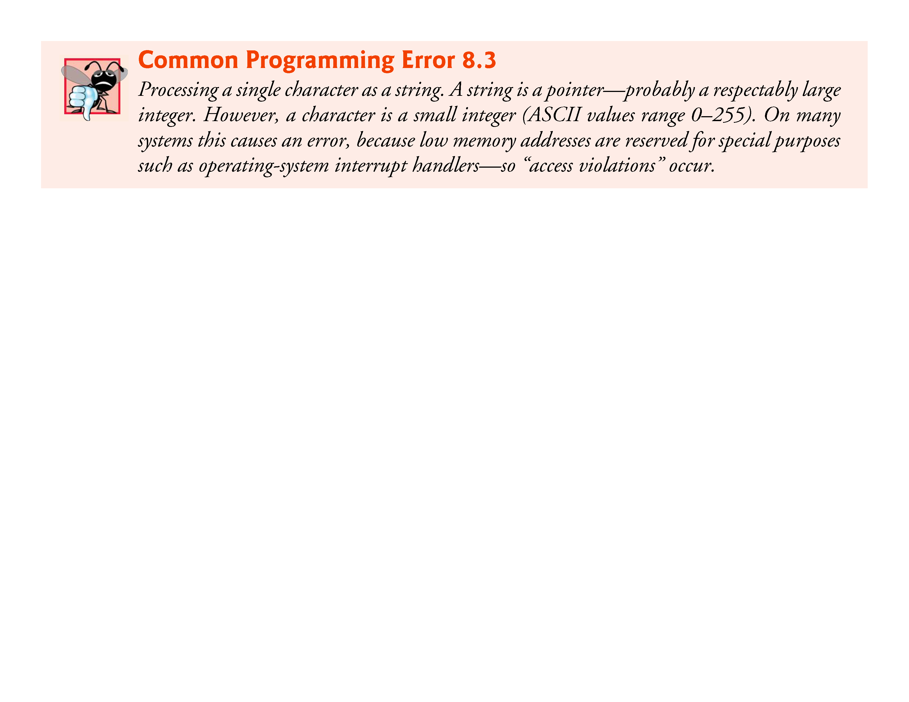
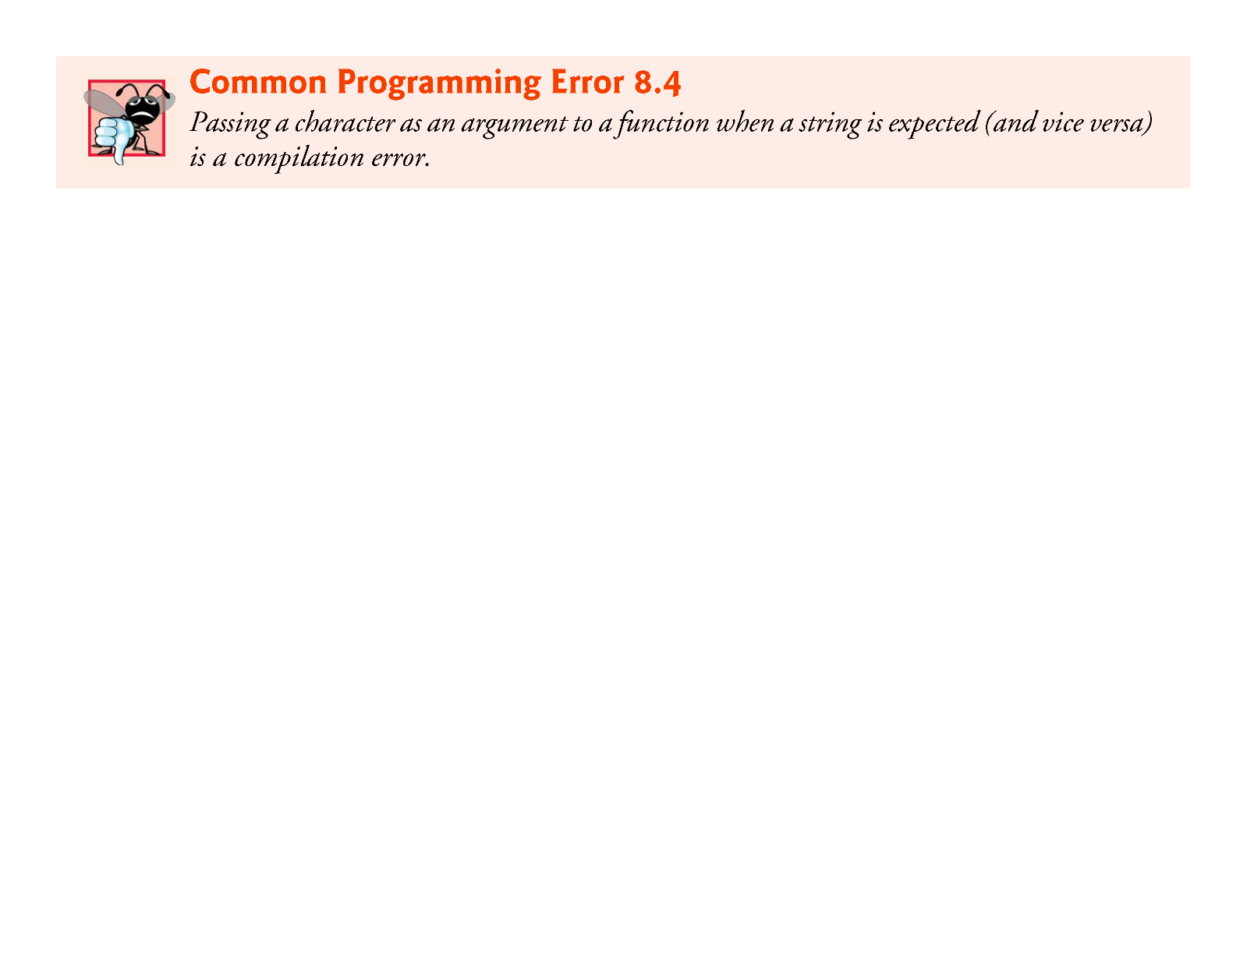
8.2 Fundamentals of Strings and Characters (Cont.)
This prevents scanf from writing characters into memory beyond the end of s.
(For reading input lines of arbitrary length, there’s a nonstandard—yet widely supported—function readline, usually included in stdio.h.)
For a character array to be printed properly as a string, the array must contain a terminating null character.

Slide 11
8.3 Character-Handling Library
The character-handling library (<ctype.h>) includes several functions that perform
useful tests
and manipulations
of character data.
Each function receives an unsigned char (represented as an int) or EOF as an argument.
EOF normally has the value –1.
Figure 8.1 summarizes the functions of the character-handling library.

Slide 12
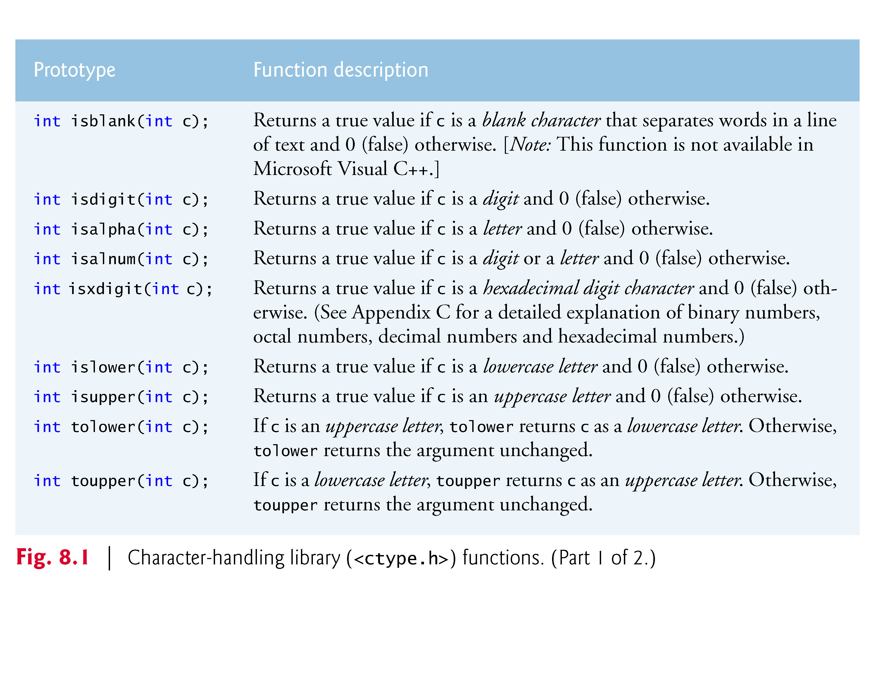

Slide 13
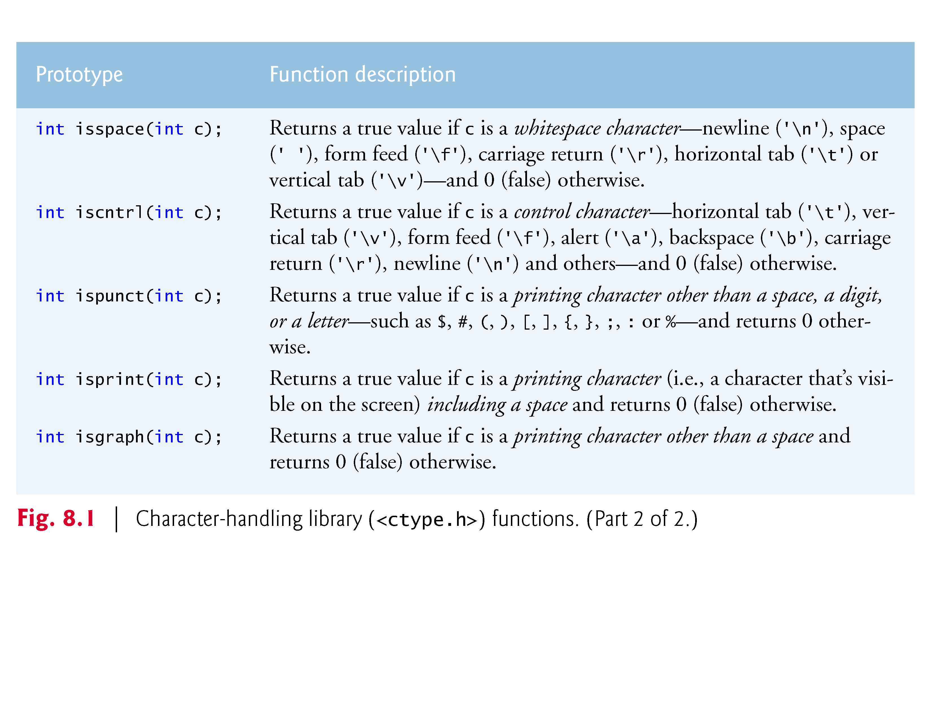

Slide 14
8.3.1 Functions isdigit, isalpha, isalnum and isxdigit
Figure 8.2 demonstrates functions isdigit, isalpha, isalnum and isxdigit.
Function isdigit determines whether its argument is a digit (0–9).
Function isalpha determines whether its argument is an uppercase (A–Z) or lowercase letter (a–z).
Function isalnum determines whether its argument is an uppercase letter, a lowercase letter or a digit.
Function isxdigit determines whether its argument is a hexadecimal digit (A–F, a–f, 0–9).

Slide 15
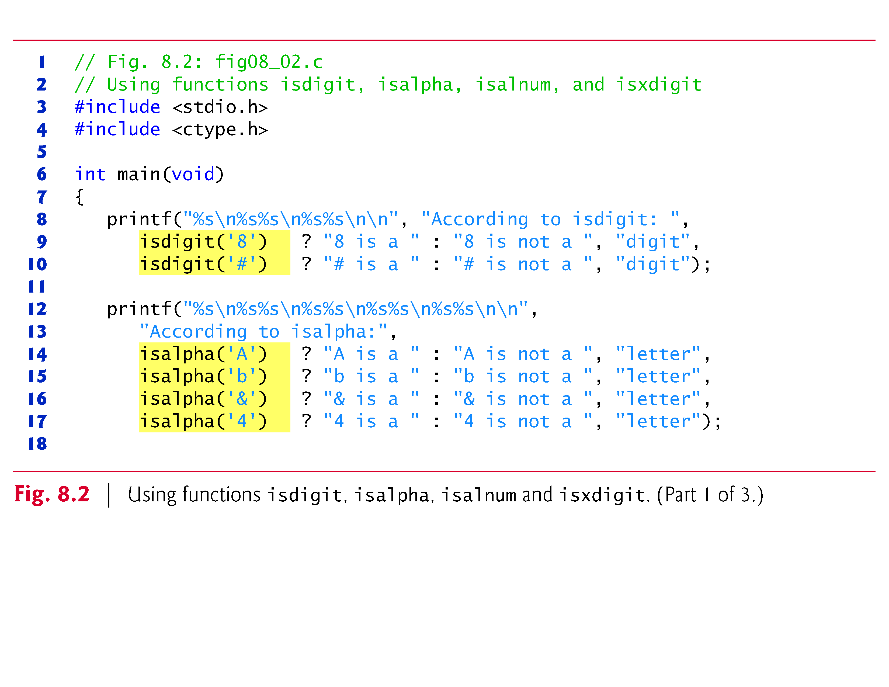

Slide 16
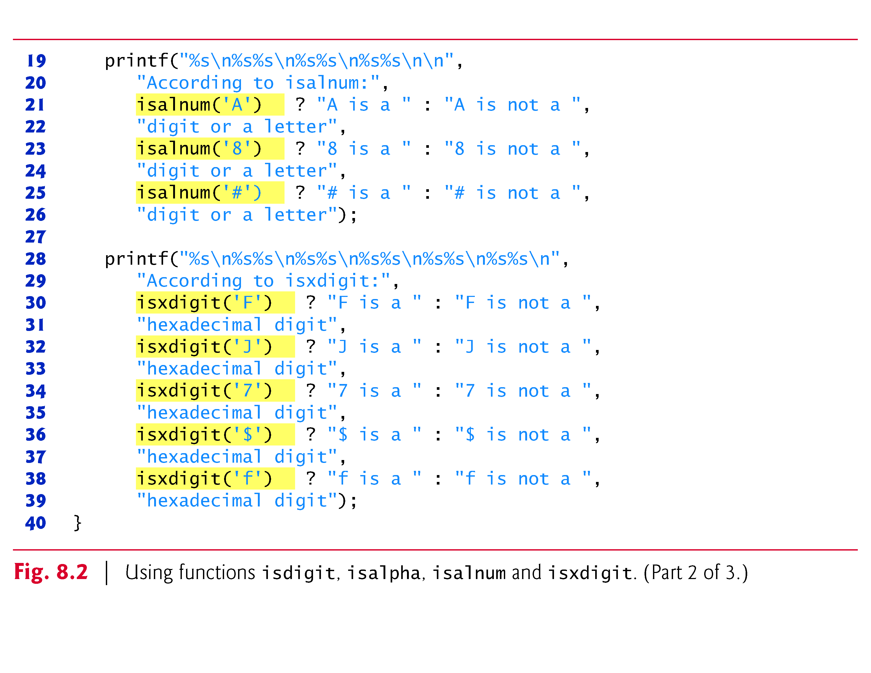

Slide 17
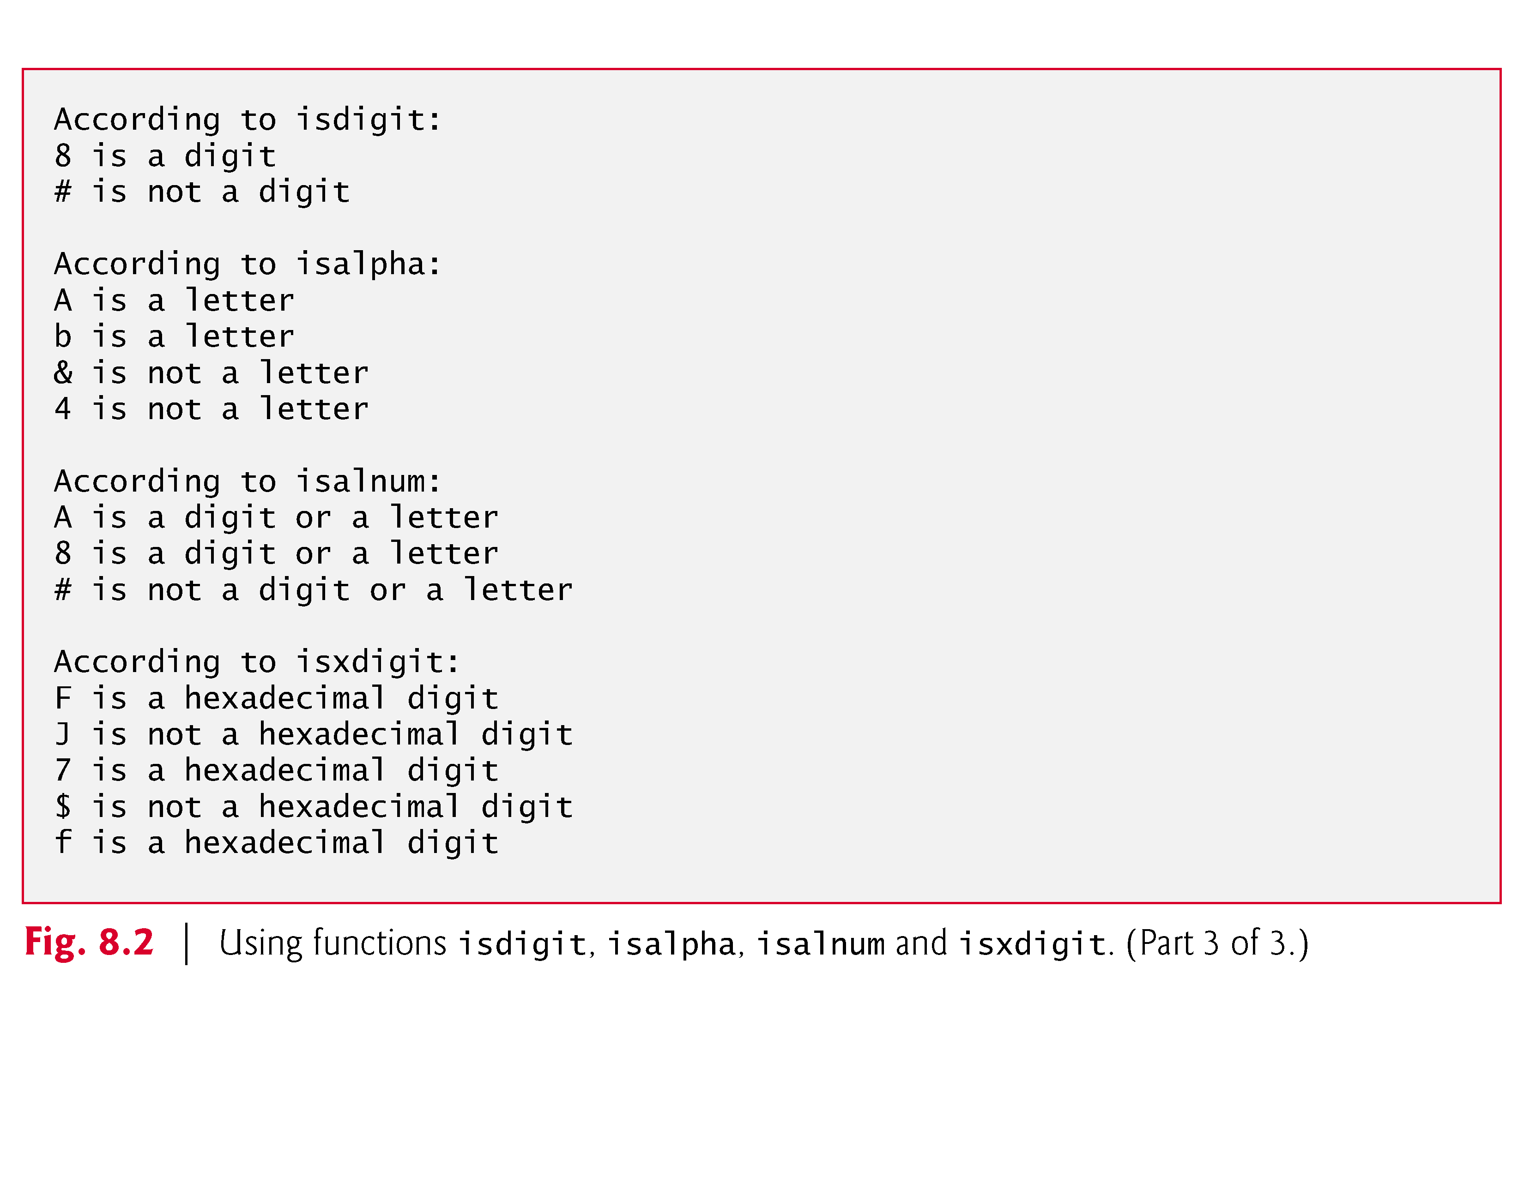

Slide 18
8.3.1 Functions isdigit, isalpha, isalnum and isxdigit (Cont.)
Figure 8.2 uses the conditional operator (?:) to determine
whether the string " is a "
or the string " is not a " should be printed in the output for each character tested.
For example, the expression
isdigit('8') ? "8 is a " : "8 is not a "
indicates that:
if '8' is a digit, the string "8 is a " is printed,
and if '8' is not a digit (i.e., isdigit returns 0), the string "8 is not a " is printed.

Slide 19
8.3.1 Functions islower, isupper, tolower and toupper
Figure 8.3 demonstrates functions islower, isupper, tolower and toupper.
Function islower determines whether its argument is a lowercase letter (a–z).
Function isupper determines whether its argument is an uppercase letter (A–Z).
Function tolower converts an uppercase letter to a lowercase letter and returns the lowercase letter.
If the argument is not an uppercase letter, tolower returns the argument unchanged.
Function toupper converts a lowercase letter to an uppercase letter and returns the uppercase letter.
If the argument is not a lowercase letter, toupper returns the argument unchanged.

Slide 20
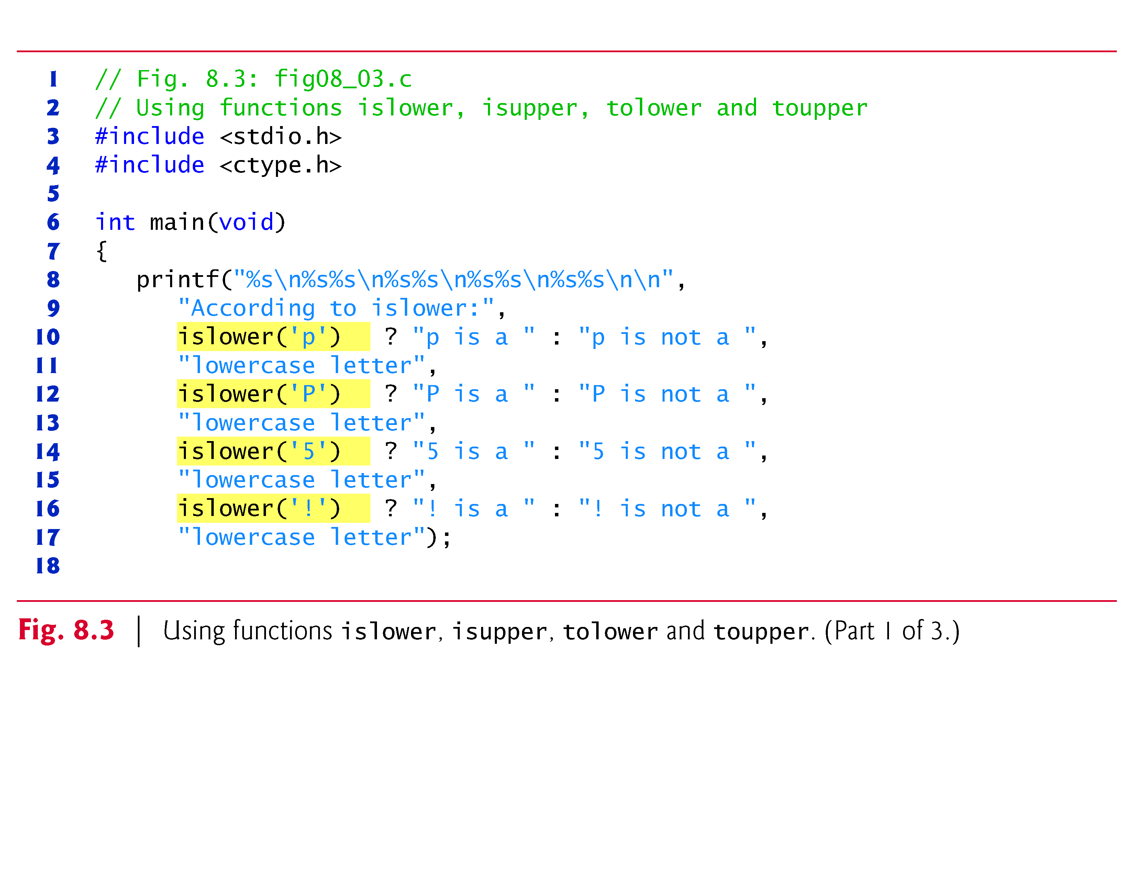

Slide 21
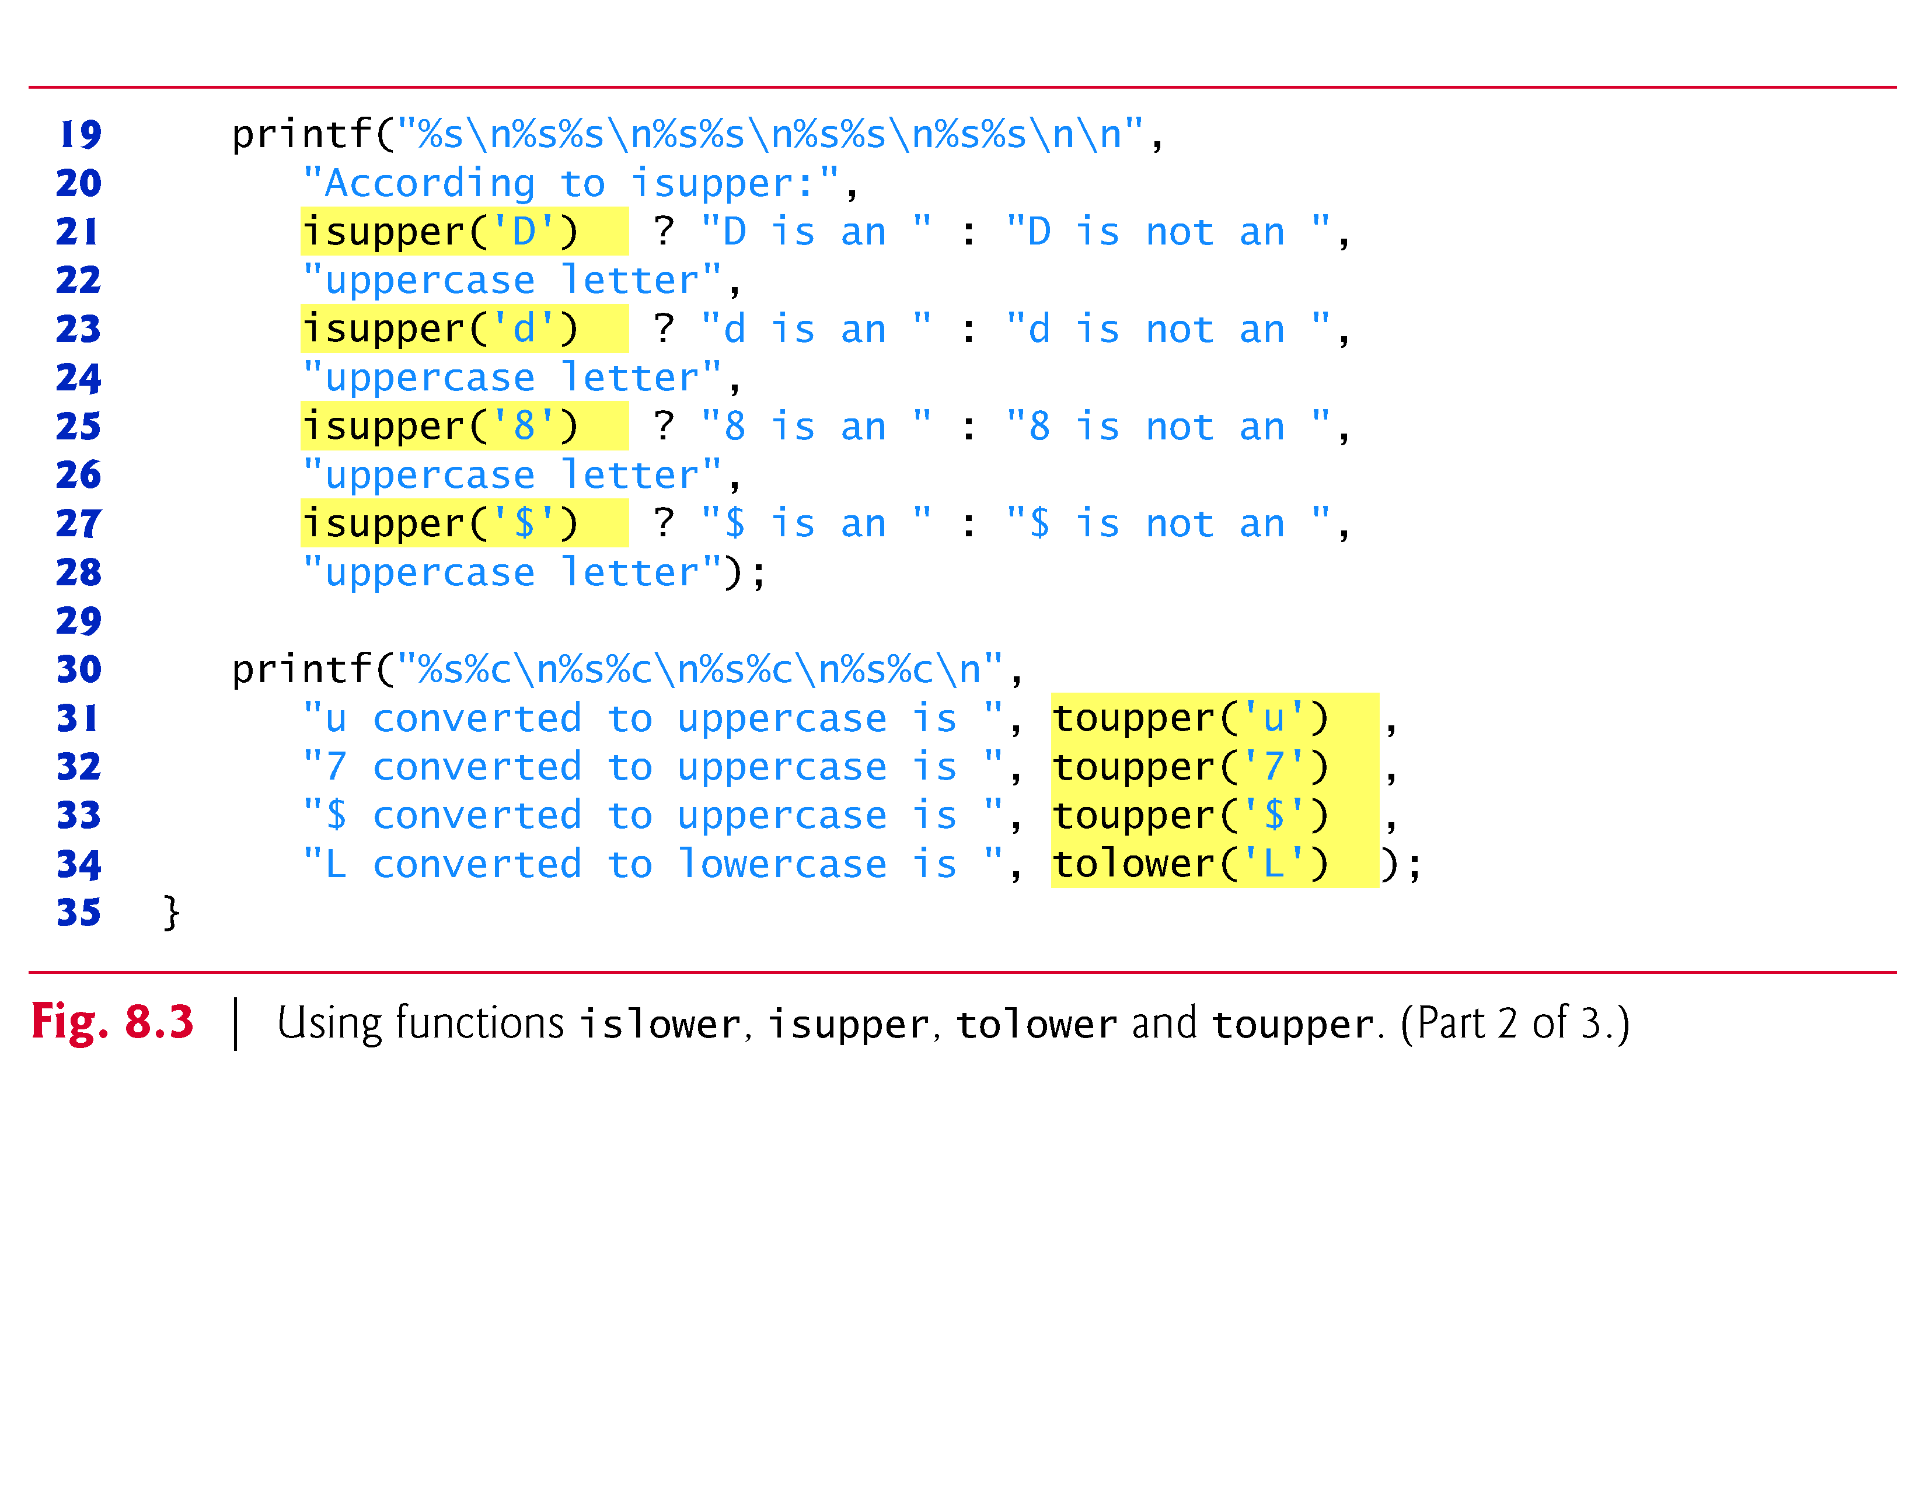

Slide 22
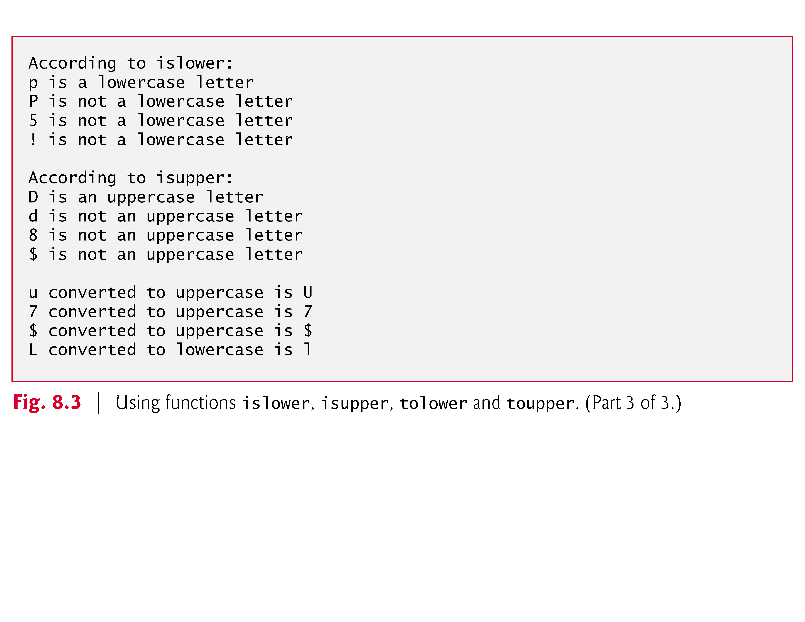

Slide 23
8.3.3 Functions isspace, iscntrl, ispunct, isprint and isgraph
Figure 8.4 demonstrates functions isspace, iscntrl, ispunct, isprint and isgraph.
Function isspace determines whether a character is one of the following whitespace characters:
space (' ‘),
form feed ('\f’),
newline ('\n’),
carriage return ('\r’),
horizontal tab ('\t’)
or vertical tab ('\v').

Slide 24
8.3.3 Functions isspace, iscntrl, ispunct, isprint and isgraph
Function iscntrl determines whether a character is one of the following control characters:
horizontal tab ('\t’),
vertical tab ('\v’),
form feed ('\f’),
alert ('\a’),
backspace ('\b’),
carriage return ('\r’)
or newline ('\n').
Function ispunct determines if a character is a printing character other than a space, a digit or a letter, such as $, #, (,), [,], {, }, ;, : or %.
Function isprint determines whether a character can be displayed on the screen (including the space character).
Function isgraph is the same as isprint, except that the space character is not included.

Slide 25
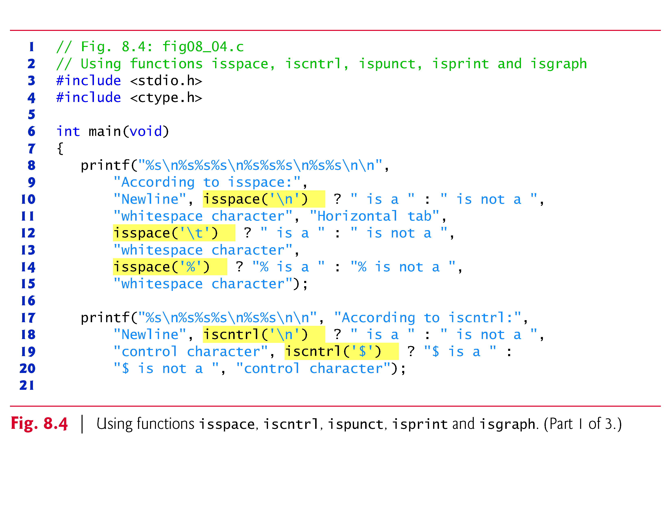

Slide 26
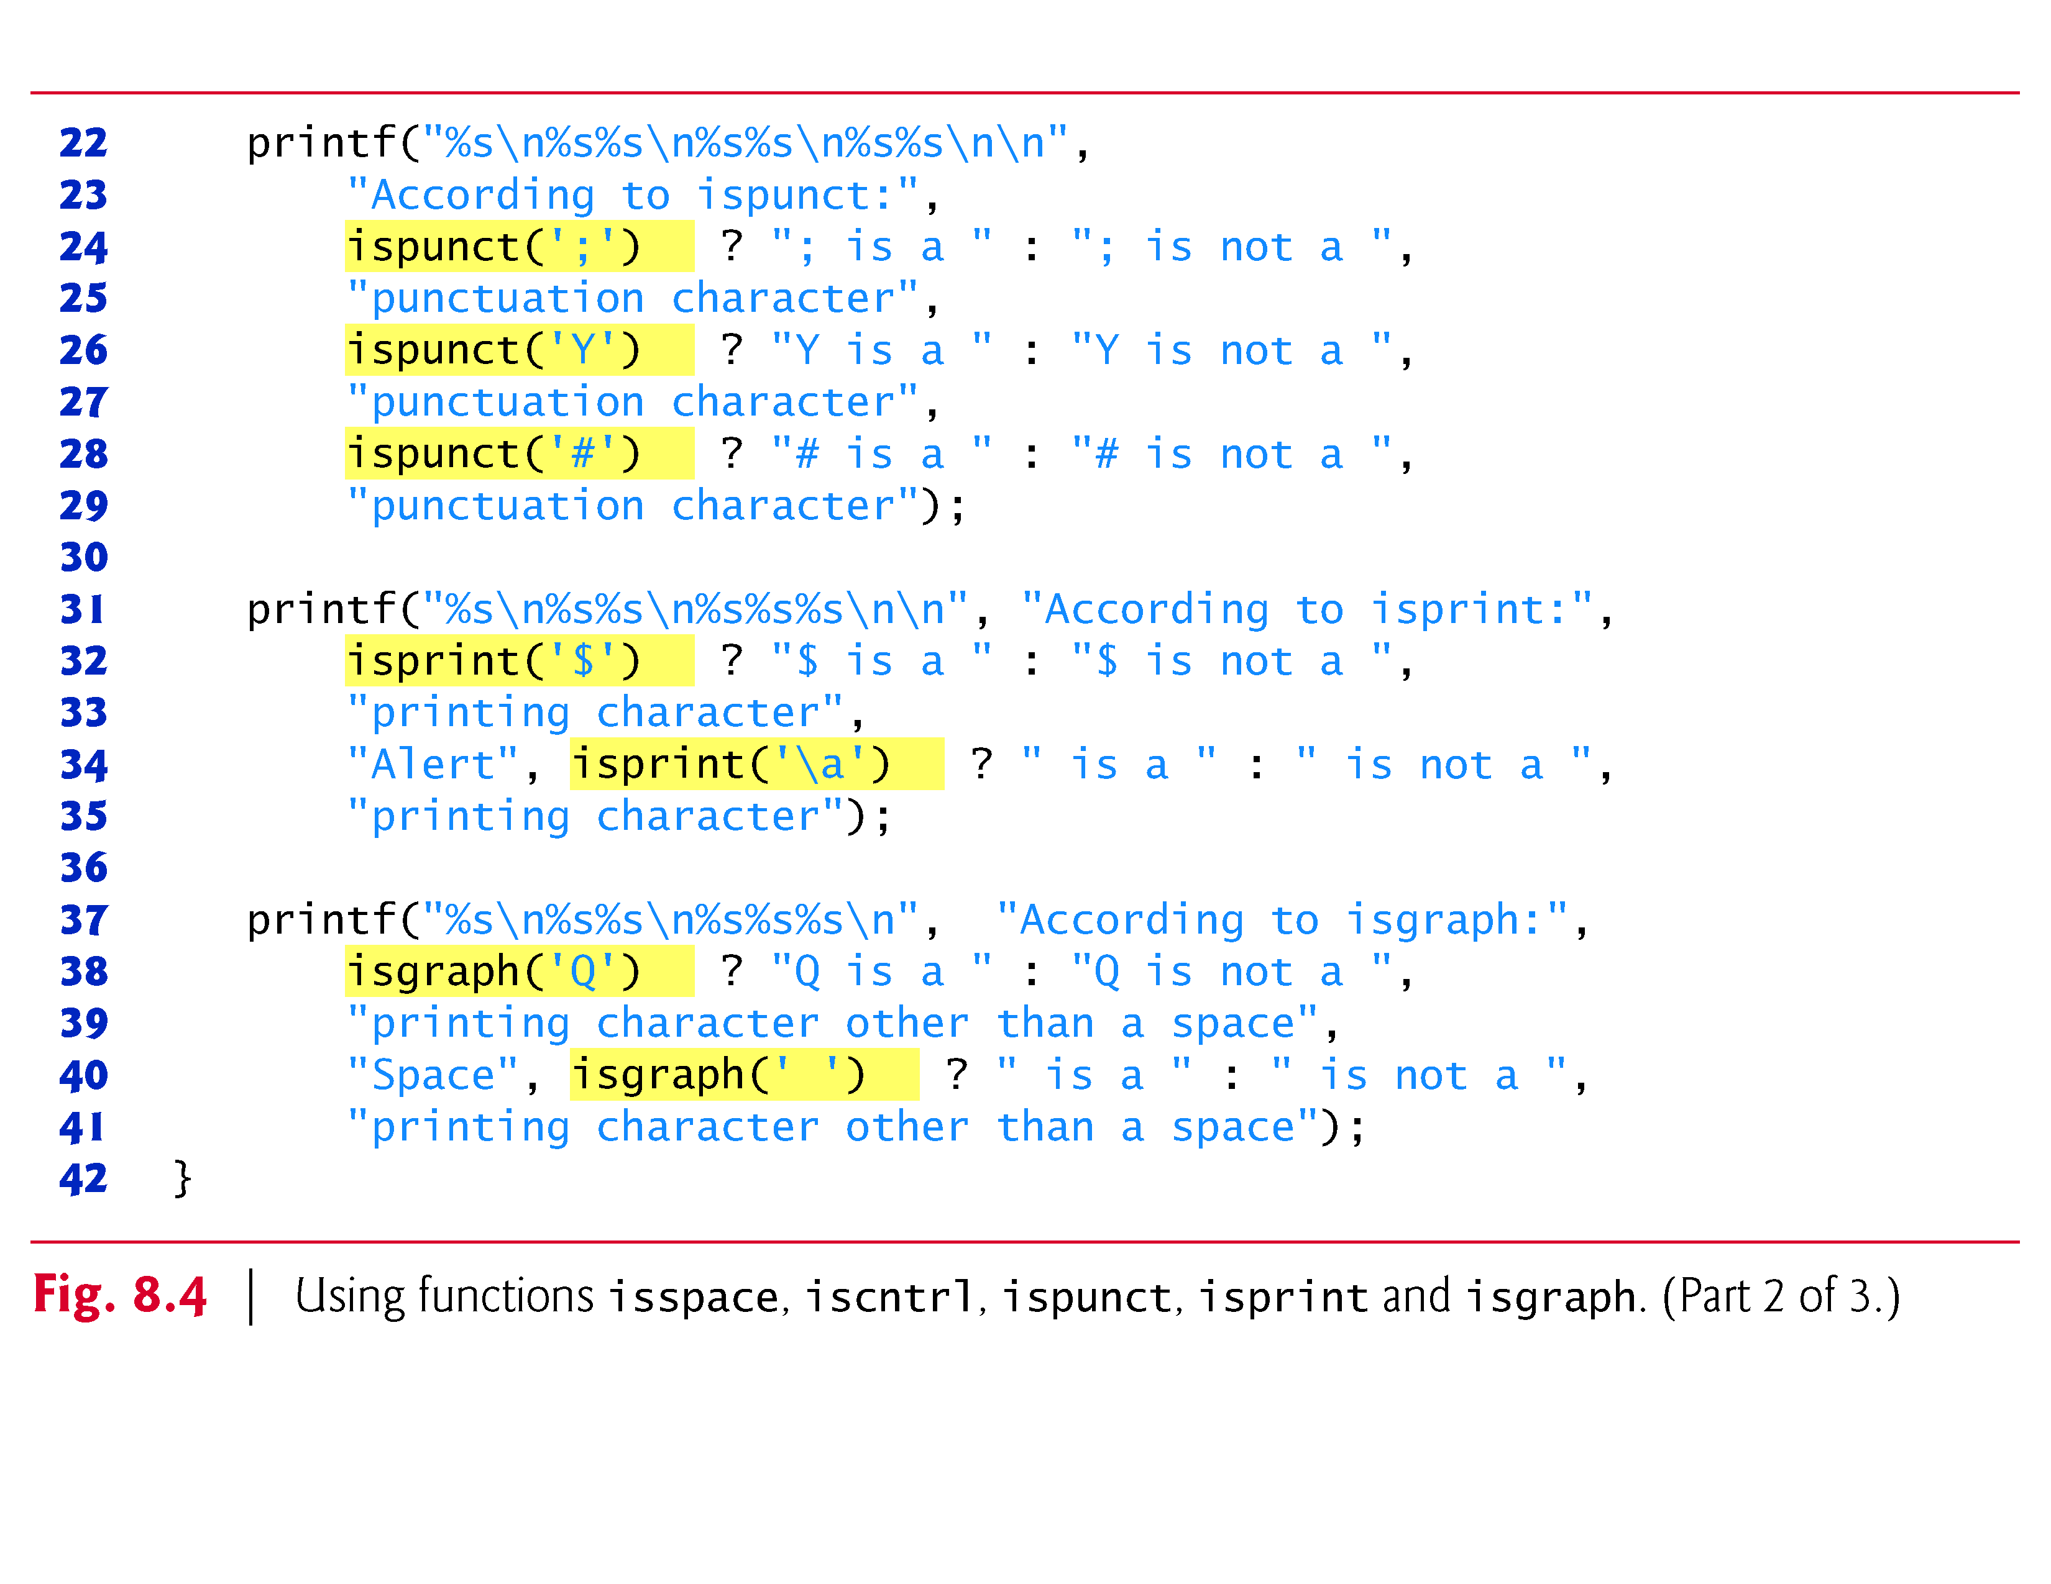

Slide 27
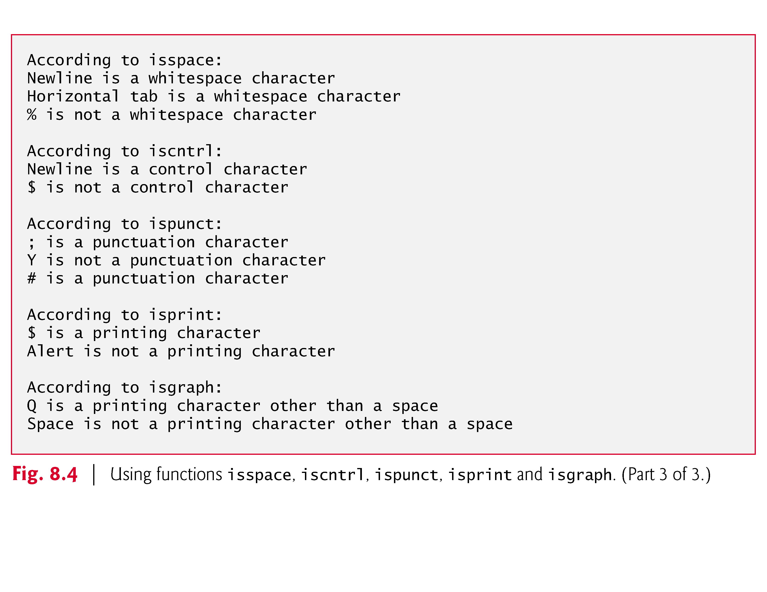

Slide 28
8.4 String-Conversion Functions
This section presents the string-conversion functions from the general utilities library (<stdlib.h>).
They convert strings of digits to integer and floating-point values.
Figure 8.5 summarizes the string-conversion functions.
The C standard also includes strtoll and strtoull for converting strings to long long int and unsigned long long int, respectively.
Note the use of const to declare variable nPtr in the function headers
(read from right to left as “nPtr is a pointer to a character constant”);
const specifies that the argument value will not be modified.

Slide 29
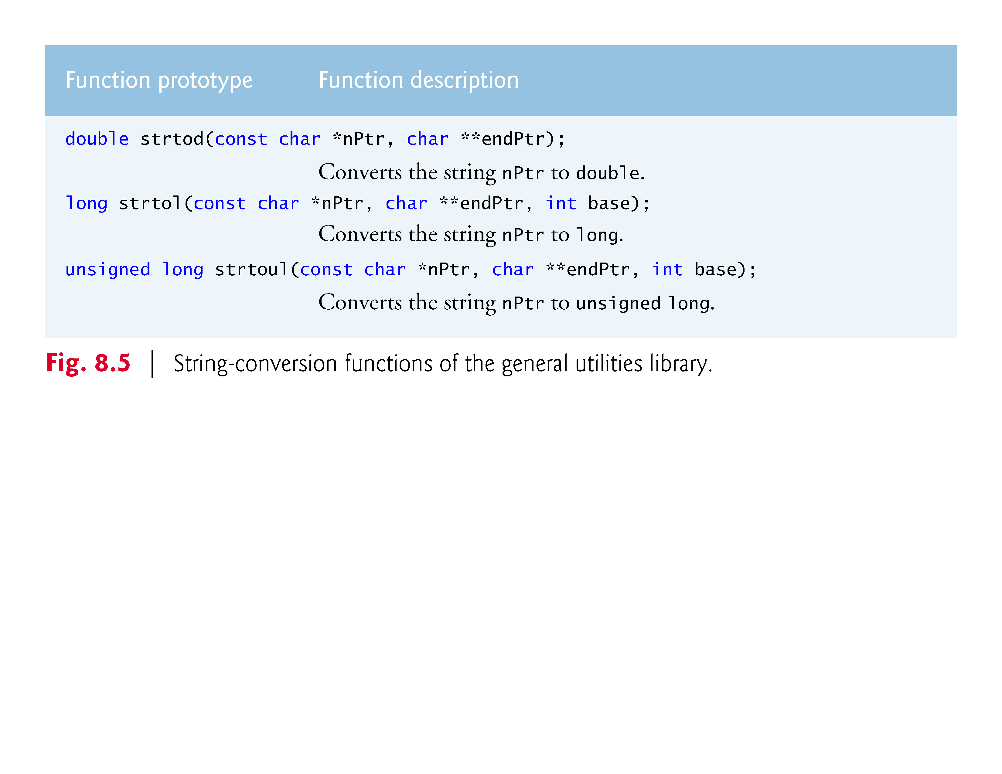

Slide 30
8.4.1 Function strtod
Function strtod (Fig. 8.6) converts a sequence of characters representing a floating-point value to double.
The function returns 0 if it’s unable to convert any portion of its first argument to double.
The function receives two arguments—
a string (char *)
and a pointer to a string (char **).
The string argument contains the character sequence to be converted to double—any whitespace characters at the beginning of the string are ignored.

Slide 31
8.4.1 Function strtod (Cont.)
The function uses the char ** argument to modify a char * in the calling function (stringPtr) so that it points to the
location of the first character after the converted portion of the string
or to the entire string if no portion can be converted.
d = strtod(string, &stringPtr);
indicates that d is assigned the double value converted from string, and stringPtr is assigned the location of the first character after the converted value (51.2) in string.

Slide 32
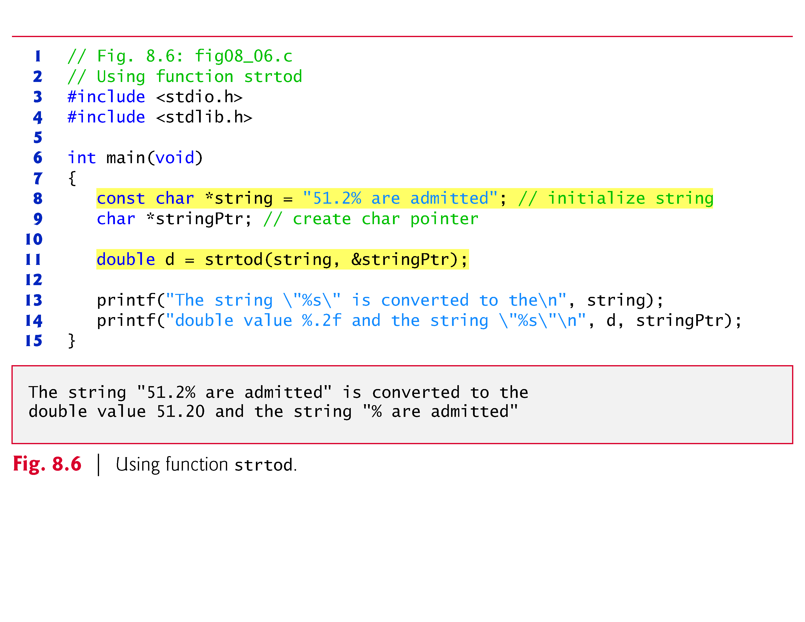

Slide 33
8.4.2 Function strtol
Function strtol (Fig. 8.7) converts to long int a sequence of characters representing an integer.
The function returns 0 if it’s unable to convert any portion of its first argument to long int.
The function receives three arguments—
a string (char *),
a pointer to a string
and an integer.
The string argument contains the character sequence to be converted to double—any whitespace characters at the beginning of the string are ignored.

Slide 34
8.4.2 Function strtol (Cont.)
The function uses the char ** argument to modify a char * in the calling function (remainderPtr) so that it points to the
location of the first character after the converted portion of the string
or to the entire string if no portion can be converted.
The integer specifies the base of the value being converted. The line
x = strtol(string, &remainderPtr, 0);
indicates that x is assigned the long value converted from string.

Slide 35
8.4.2 Function strtol (Cont.)
x = strtol(string, &remainderPtr, 0);
The second argument, remainderPtr, is assigned the remainder of string after the conversion.
Using NULL for the second argument causes the remainder of the string to be ignored.
The third argument, 0, indicates that the value to be converted can be in octal (base 8), decimal (base 10) or hexadecimal (base 16) format.
The base can be specified as:
0
or any value between 2 and 36.
Numeric representations of integers from base 11 to base 36 use the characters A–Z to represent the values 10 to 35.

Slide 36
8.4.2 Function strtol (Cont.)
For example, hexadecimal values (base 16) can consist of the digits 0–9 and the characters A–F.
A base-11 integer can consist of the digits 0–9 and the character A.
A base-24 integer can consist of the digits 0–9 and the characters A–N.
A base-36 integer can consist of the digits 0–9 and the characters A–Z.
The function returns 0 if it’s unable to convert any portion of its first argument to a long int value.

Slide 37
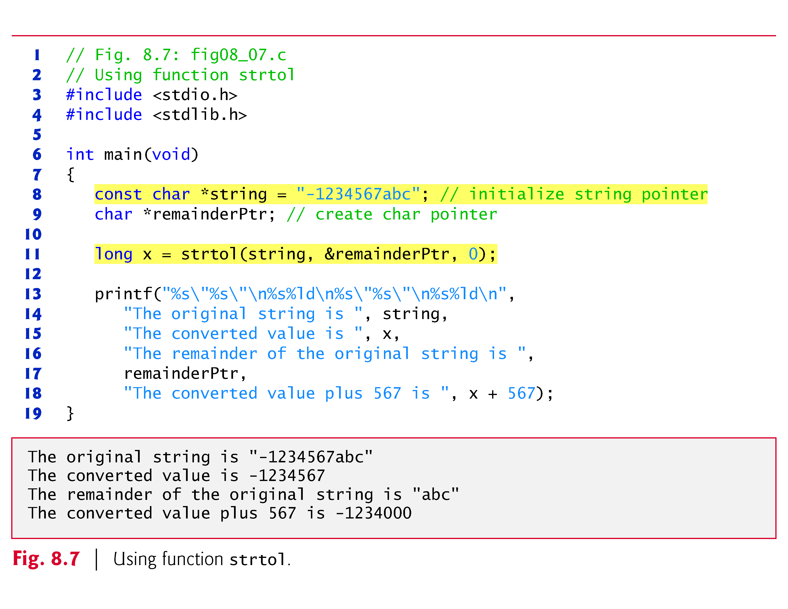

Slide 38
8.4.3 Function strtoul
Function strtoul (Fig. 8.8) converts to unsigned long int a sequence of characters representing an unsigned long int value.
The function works identically to function strtol. The statement
x = strtoul(string, &remainderPtr, 0);
in Fig. 8.8 indicates that x is assigned the unsigned long int value converted from string.
The second argument, &remainderPtr, is assigned the remainder of string after the conversion.
The third argument, 0, indicates that the value to be converted can be in octal, decimal or hexadecimal format.

Slide 39
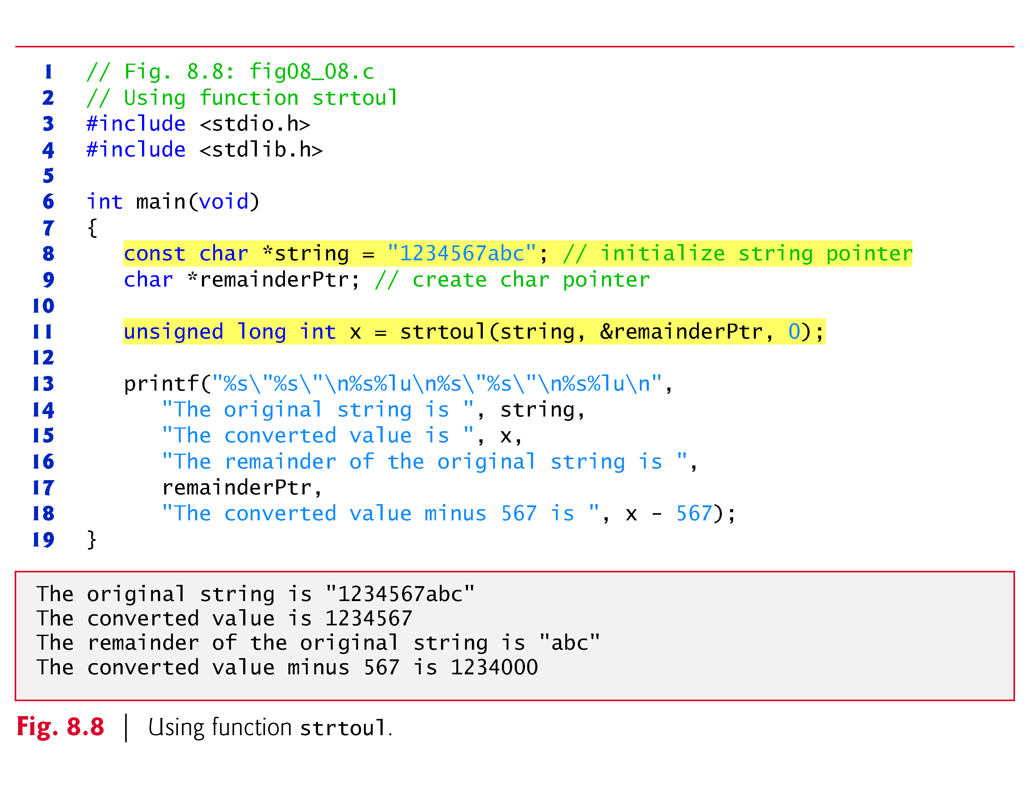

Slide 40
8.5 Standard Input/Output Library Functions
This section presents several functions from
the standard input/output library as (<stdio.h>)
specifically for manipulating character
and string data.
Figure 8.12 summarizes the character and string input/output functions of the standard input/output library.

Slide 41
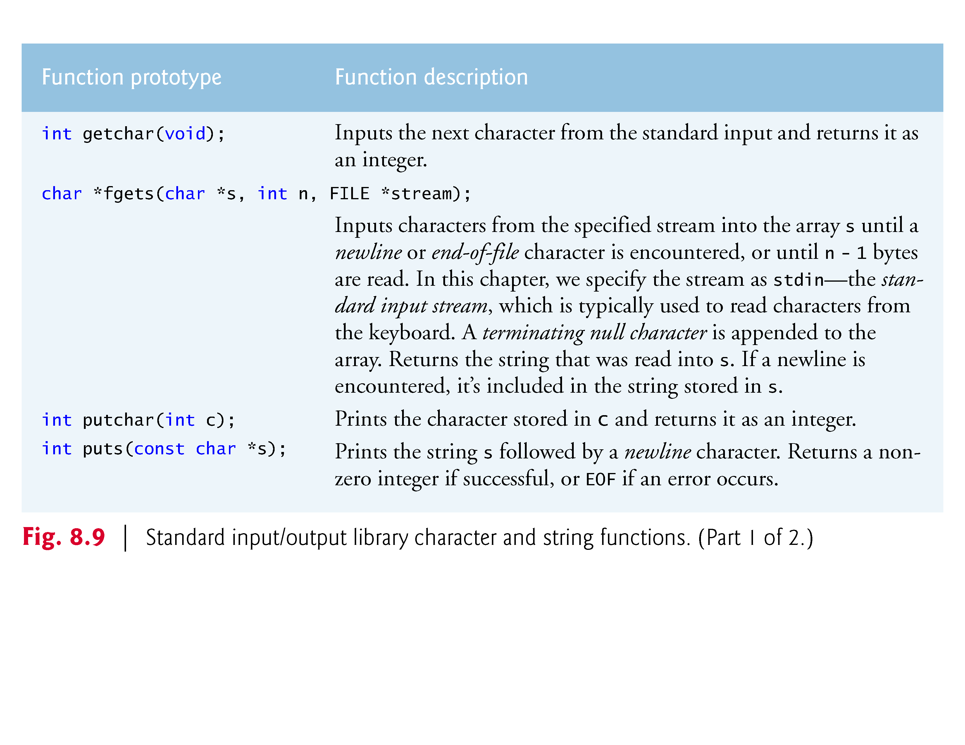

Slide 42
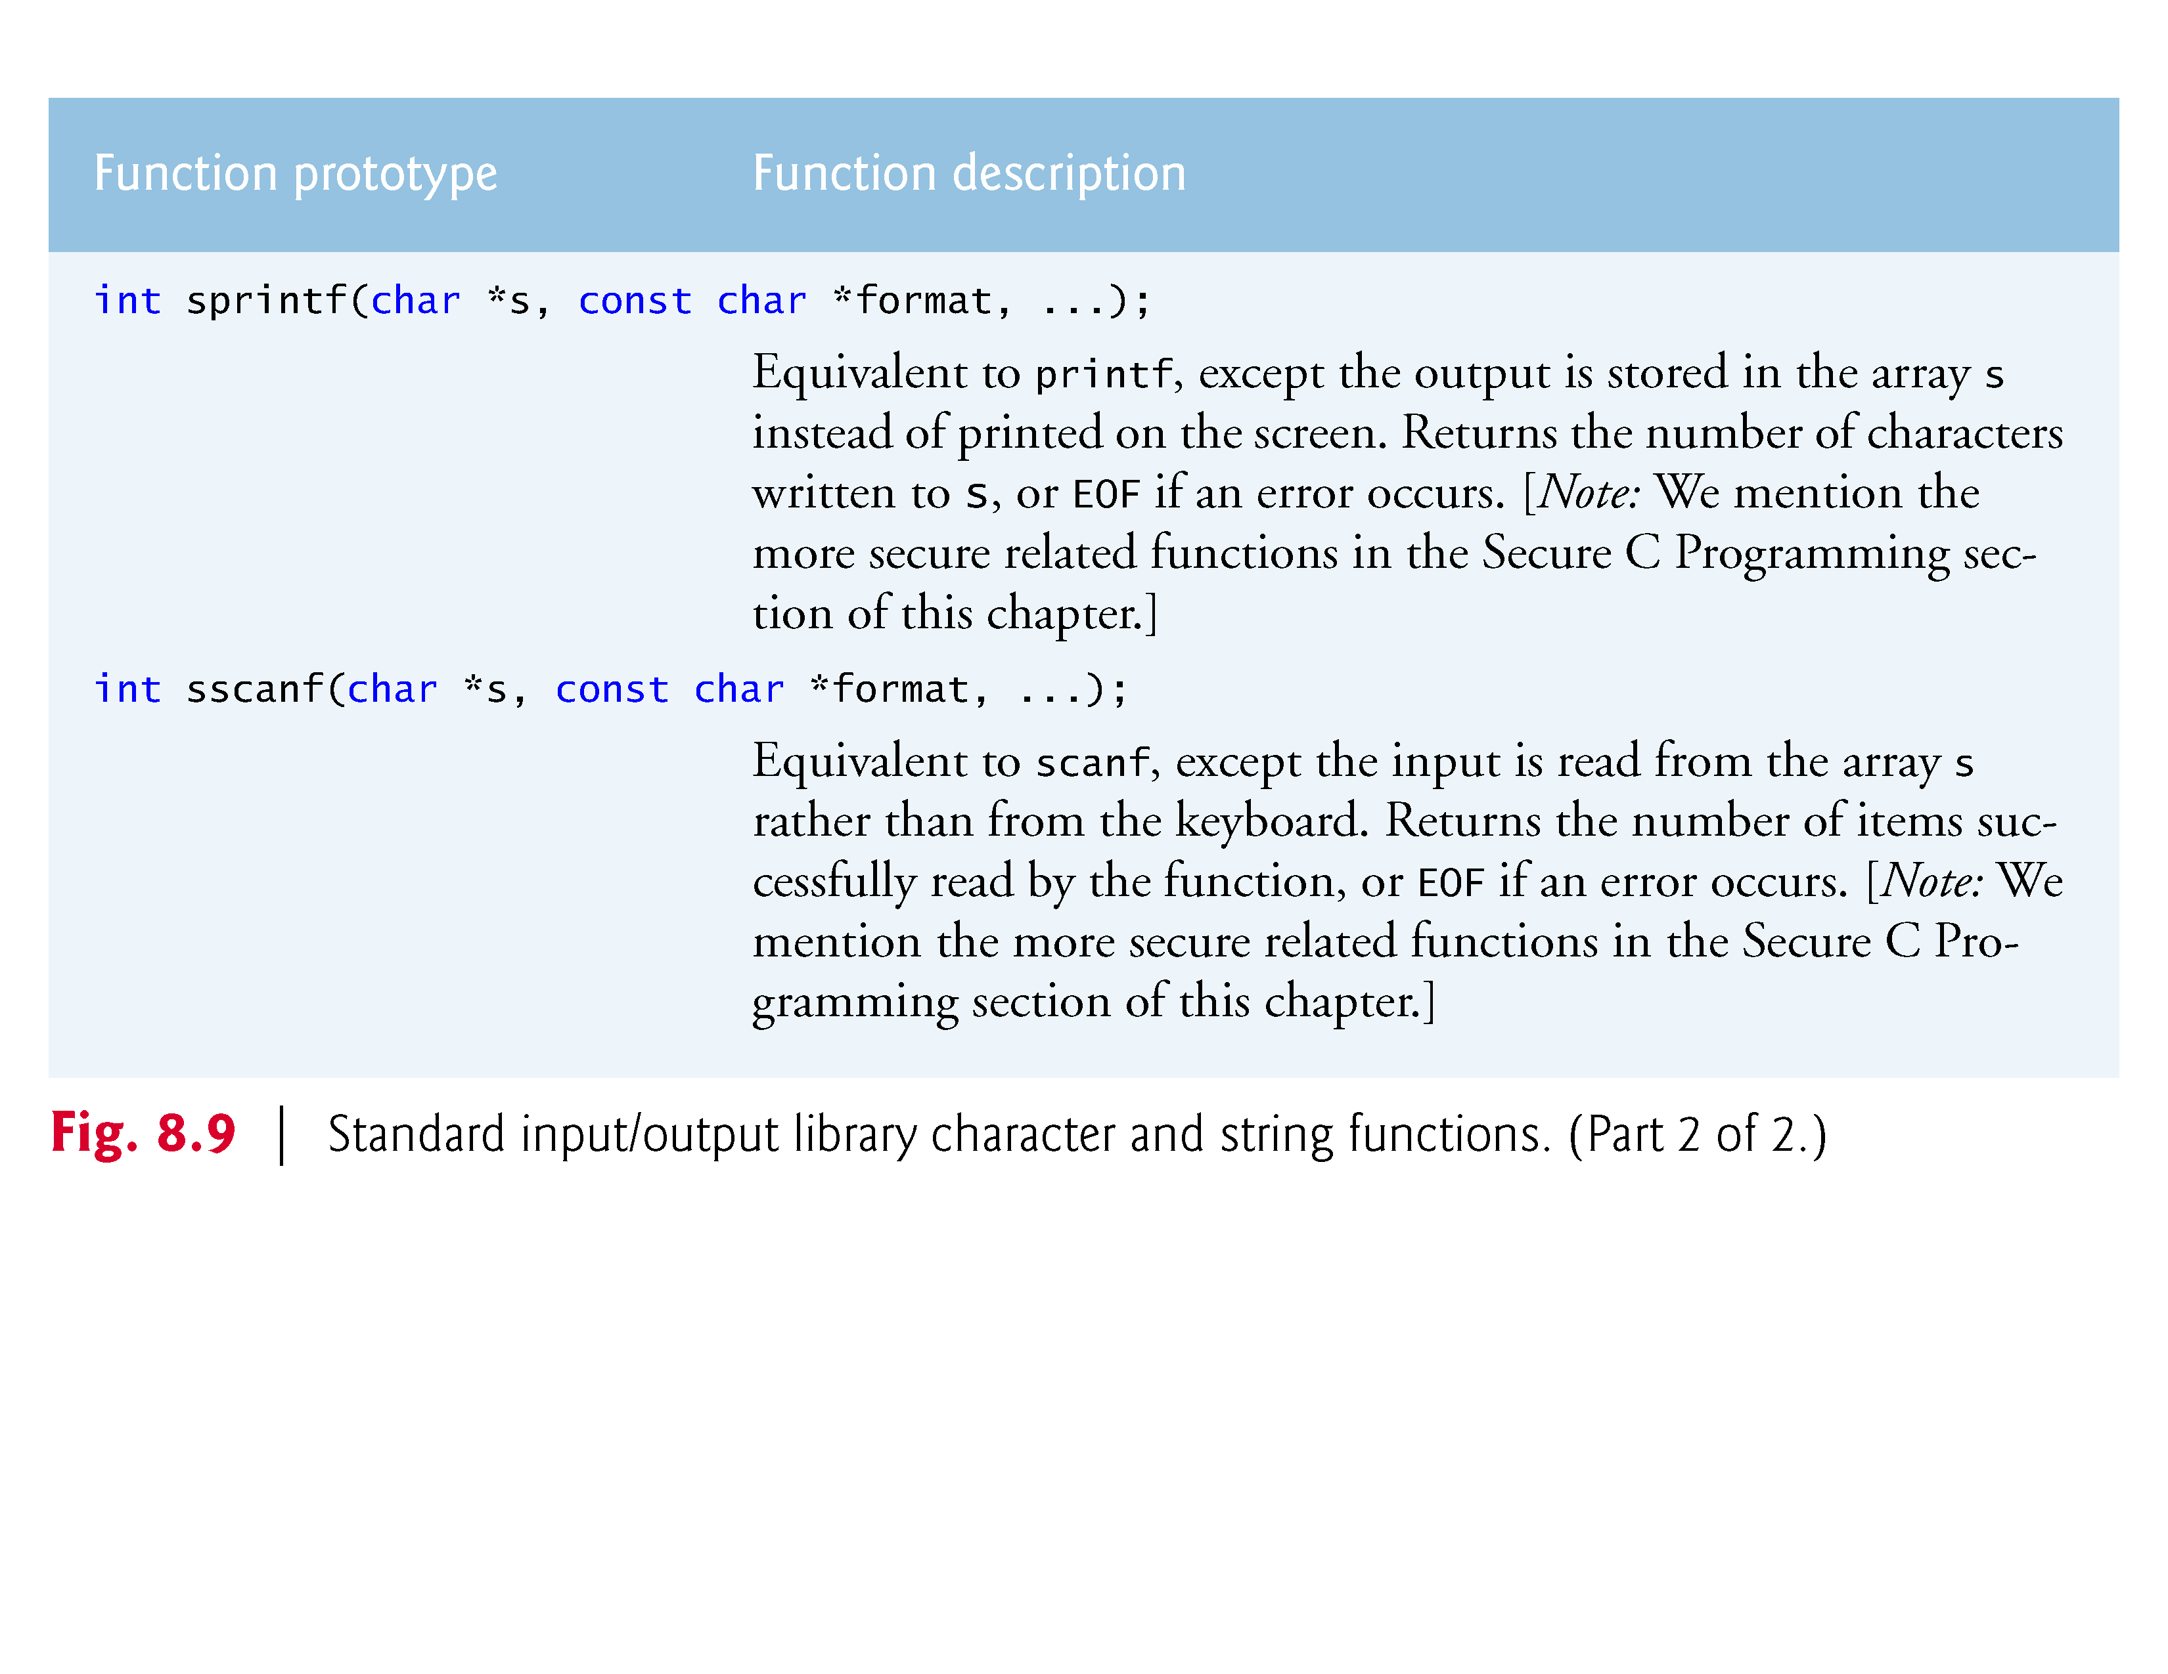

Slide 43
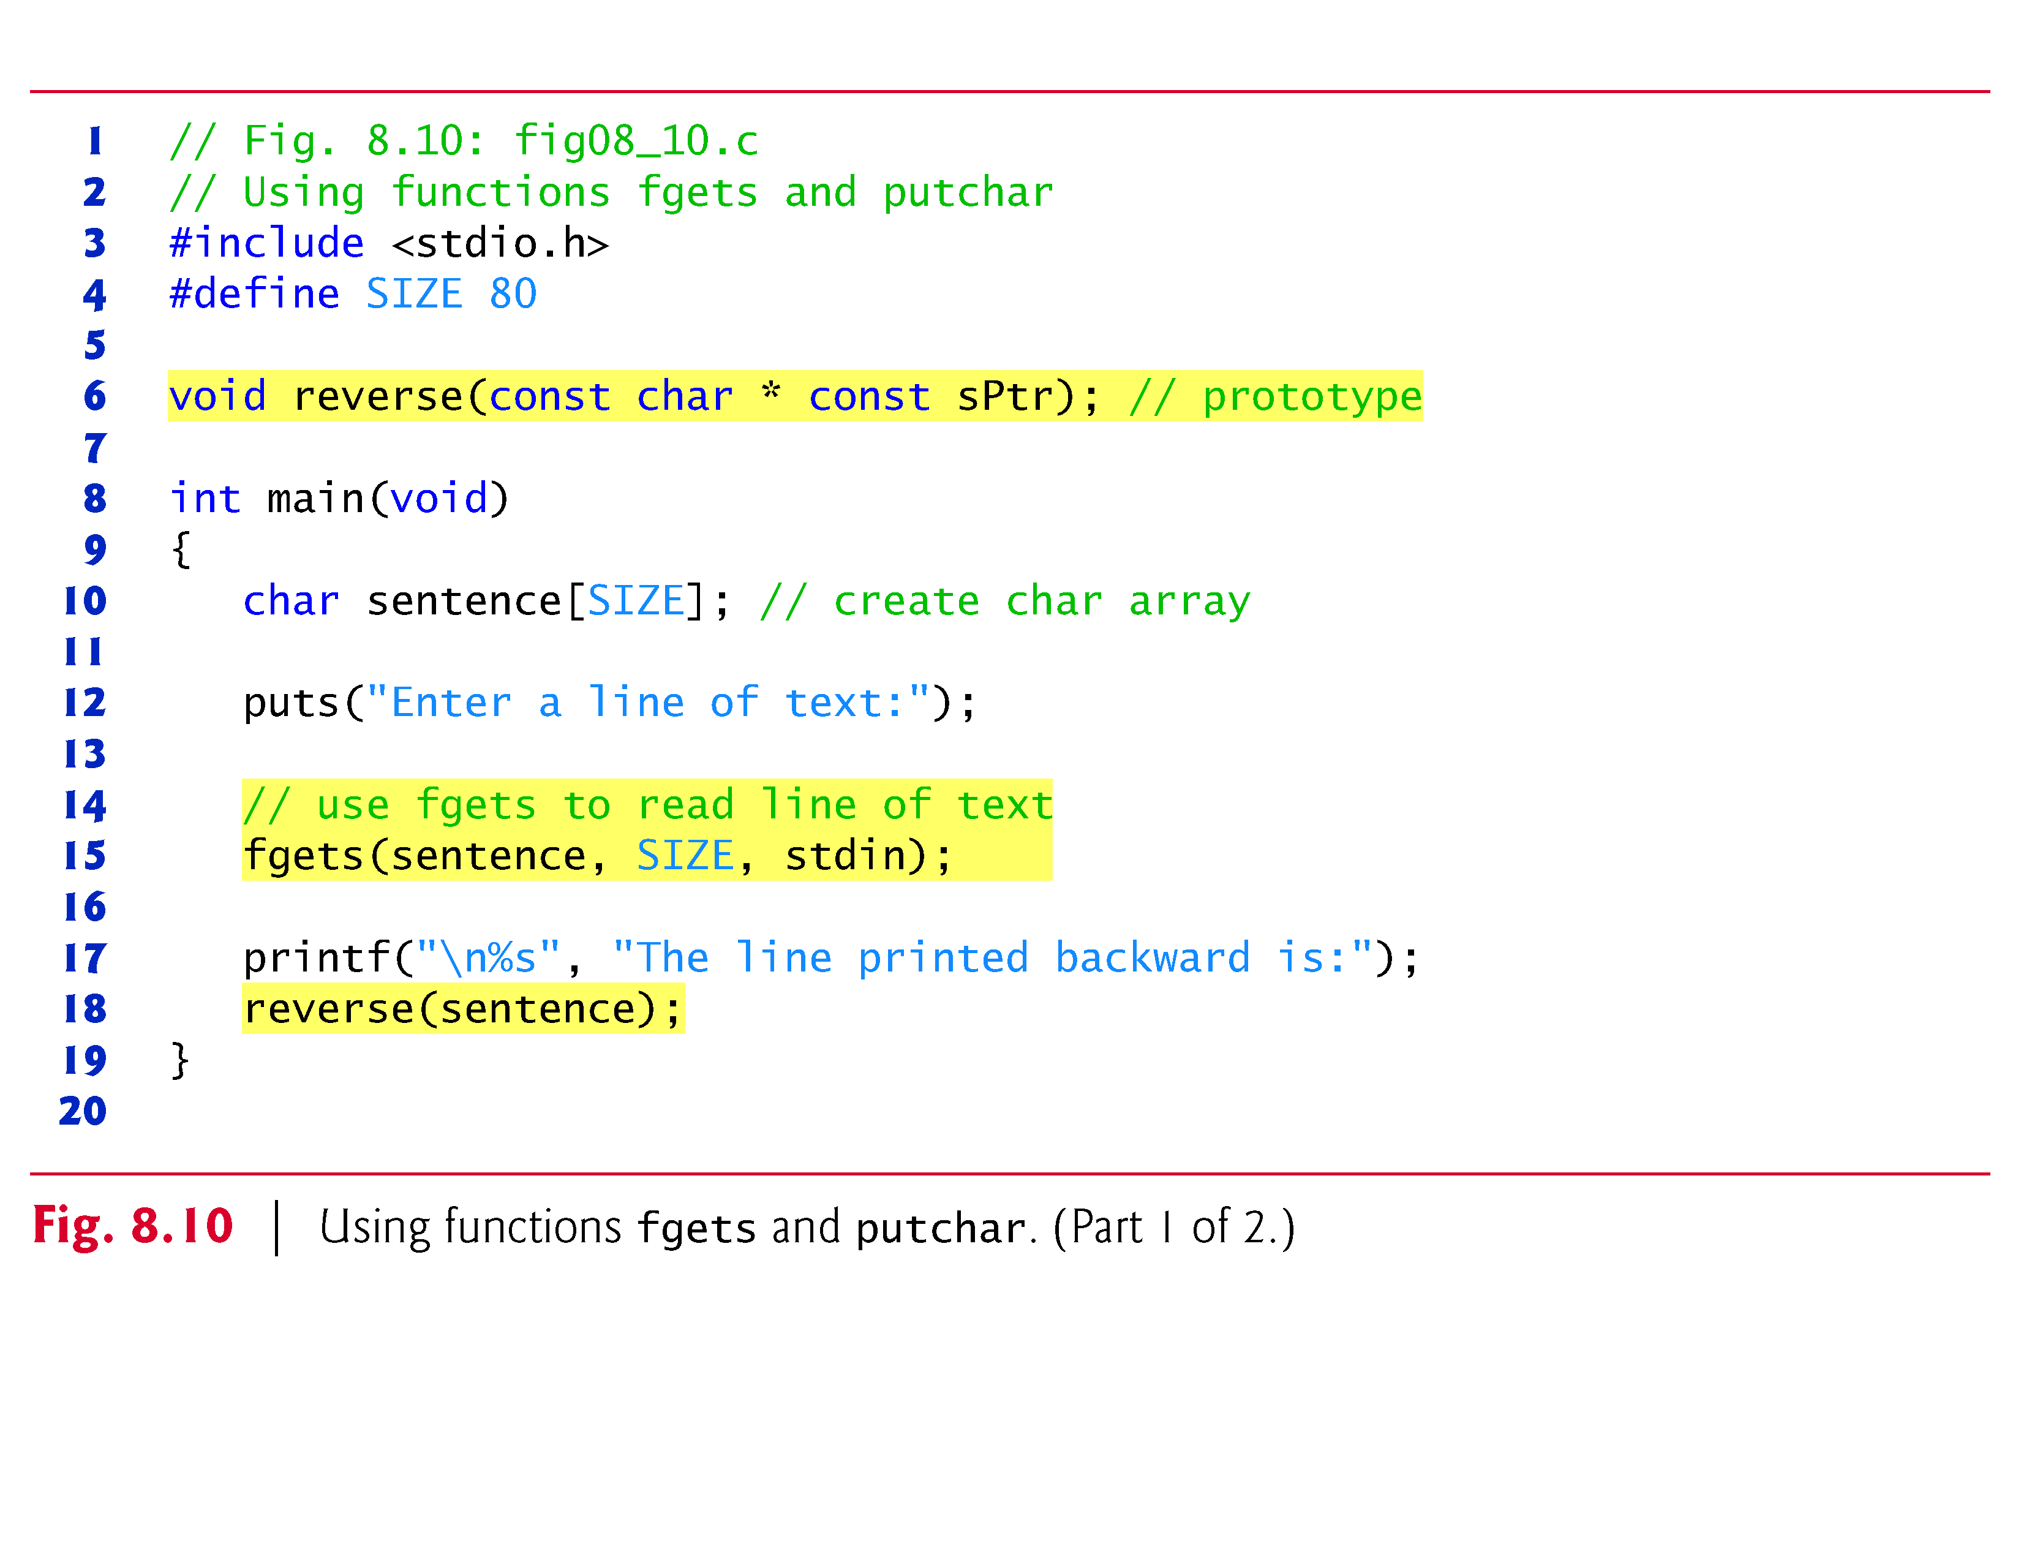
8.5.1 Functions fgets and putchar
Figure 8.10 uses functions fgets and putchar to read a line of text from the standard input (keyboard) and recursively output the characters of the line in reverse order.
Function fgets reads characters from the standard input into its first argument—an array of chars—
until a newline or the end-of-file indicator is encountered,
or until the maximum number of characters is read.
The maximum number of characters is one less than the value specified in fgets’s second argument.

Slide 44
8.5.1 Functions fgets and putchar (Cont.)
The third argument specifies the stream from which to read characters;
in this case, we use the standard input stream (stdin).
A null character ('\0') is appended to the array when reading terminates.
Function putchar prints its character argument.
The program calls recursive function reverse to print the line of text backward.

Slide 45
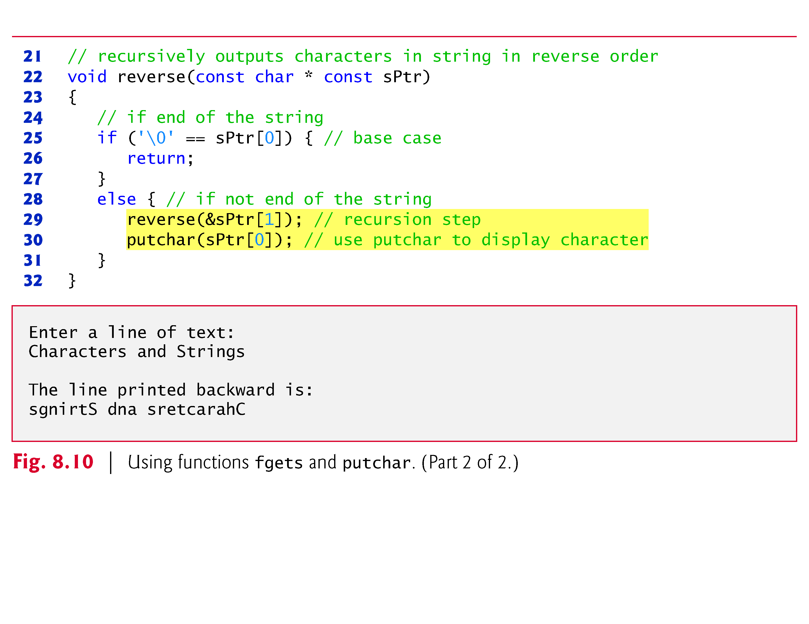
8.5.1 Functions fgets and putchar (Cont.)
If the first character of the array received by reverse is the null character '\0', reverse returns.
Otherwise, reverse is called again with the address of the subarray beginning at element sPtr[1],
and character sPtr[0] is output with putchar when the recursive call is completed.

Slide 46
8.5.1 Functions fgets and putchar (Cont.)
The order of the two statements in the else portion of the if statement causes reverse to walk to the terminating null character of the string before a character is printed.
As the recursive calls are completed, the characters are output in reverse order.

Slide 49
8.5.2 Function getchar
Figure 8.11 uses functions getchar and puts to read characters from the standard input into character array sentence and display the characters as a string.
Function getchar reads a character from the standard input and returns the character as an integer.
Function puts takes a string as an argument and displays the string followed by a newline character.
The program stops inputting characters either
when 79 characters have been read
or when getchar reads the newline character entered by the user to end the line.
A null character is appended to array sentence so that the array may be treated as a string.
Then, we use puts to display the string contained in sentence.

Slide 50
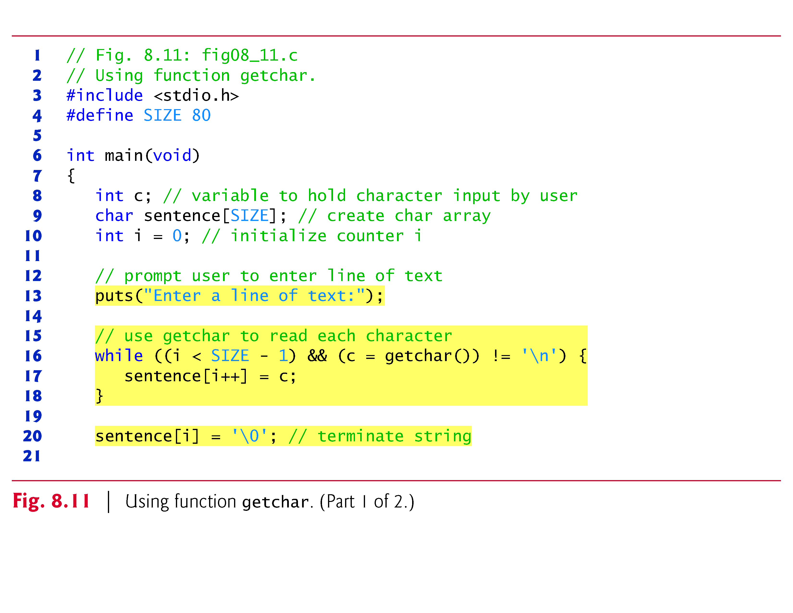

Slide 51
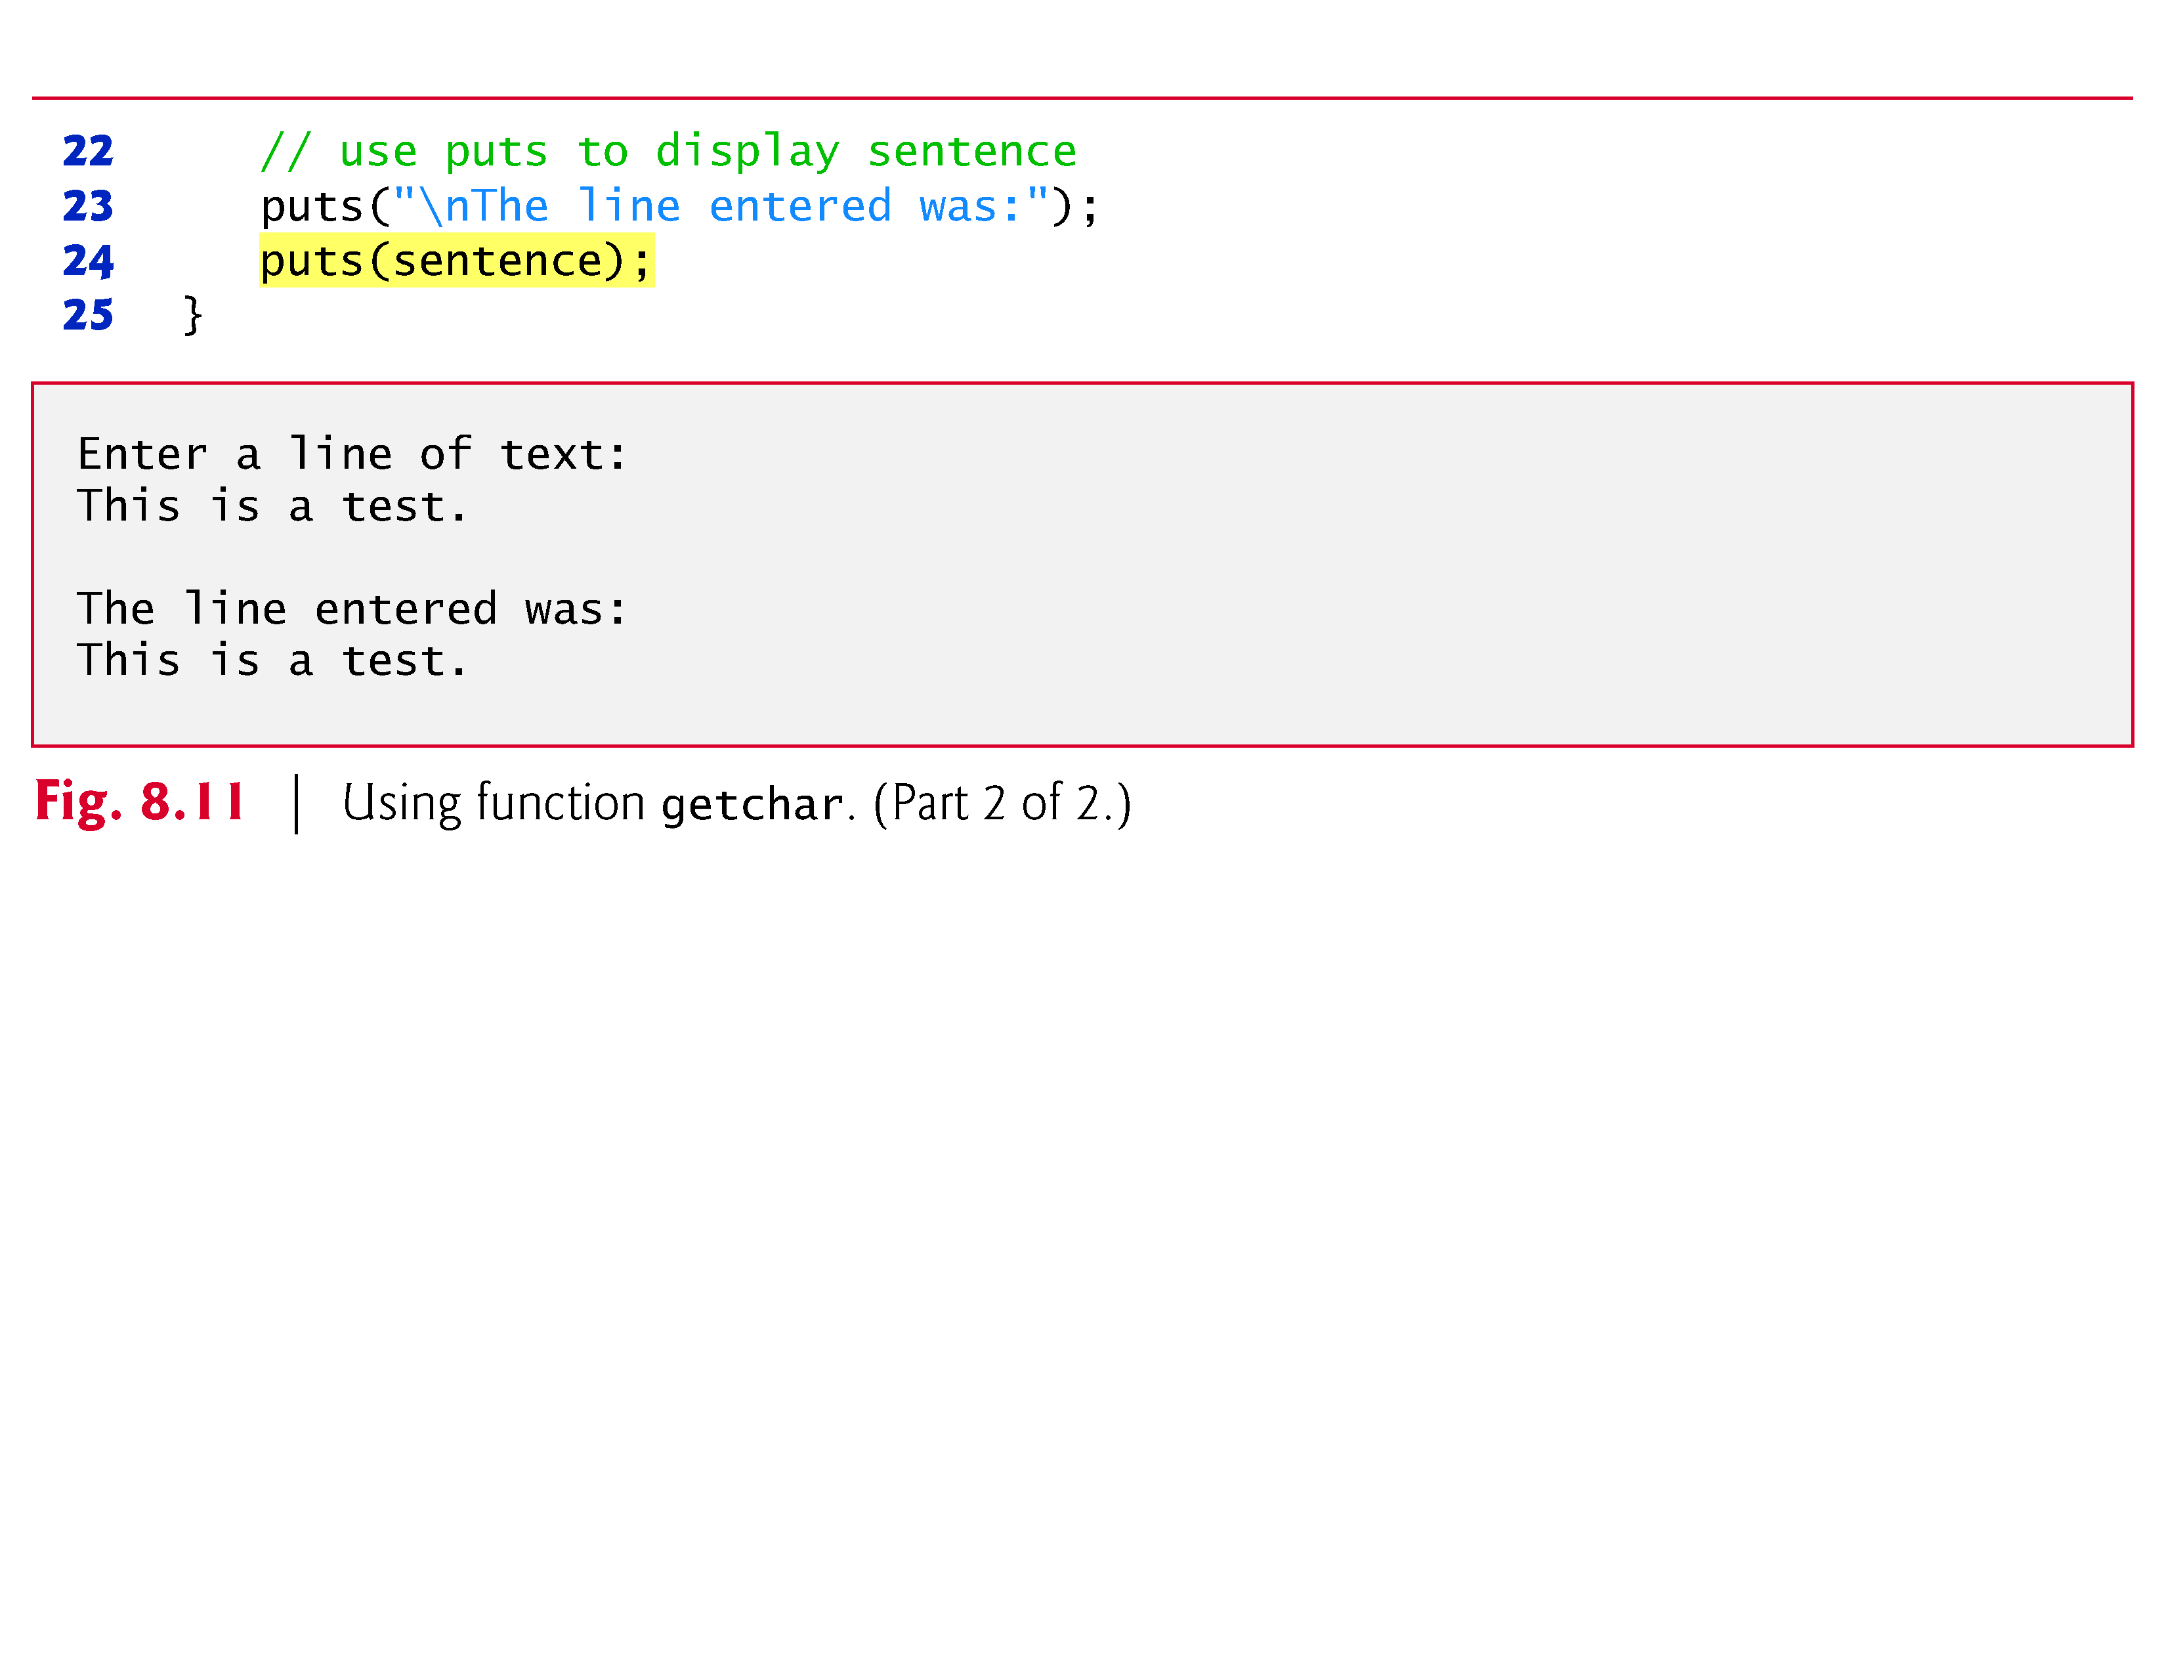

Slide 52
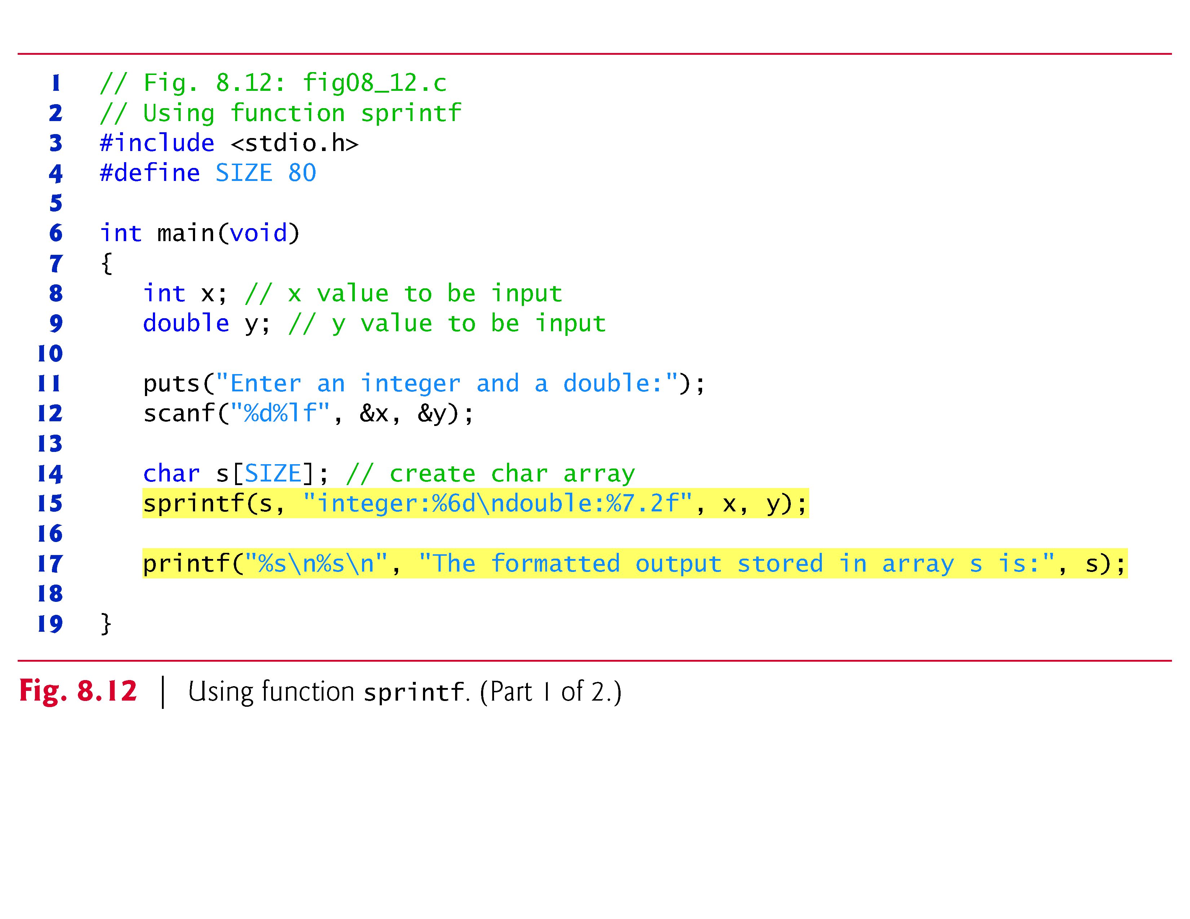
8.5.3 Function sprintf
Figure 8.12 uses function sprintf to print formatted data into array s (an array of characters).
The function uses the same conversion specifiers as printf .
The program inputs an int value and a double value to be formatted and printed to array s.
Array s is the first argument of sprintf.

Slide 54
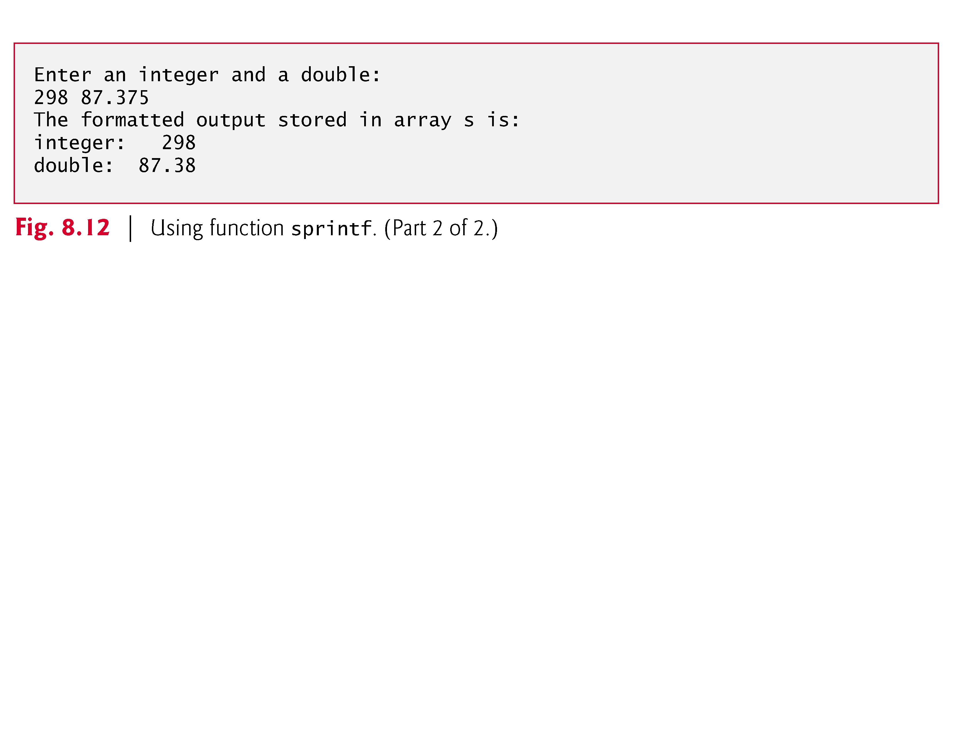

Slide 55
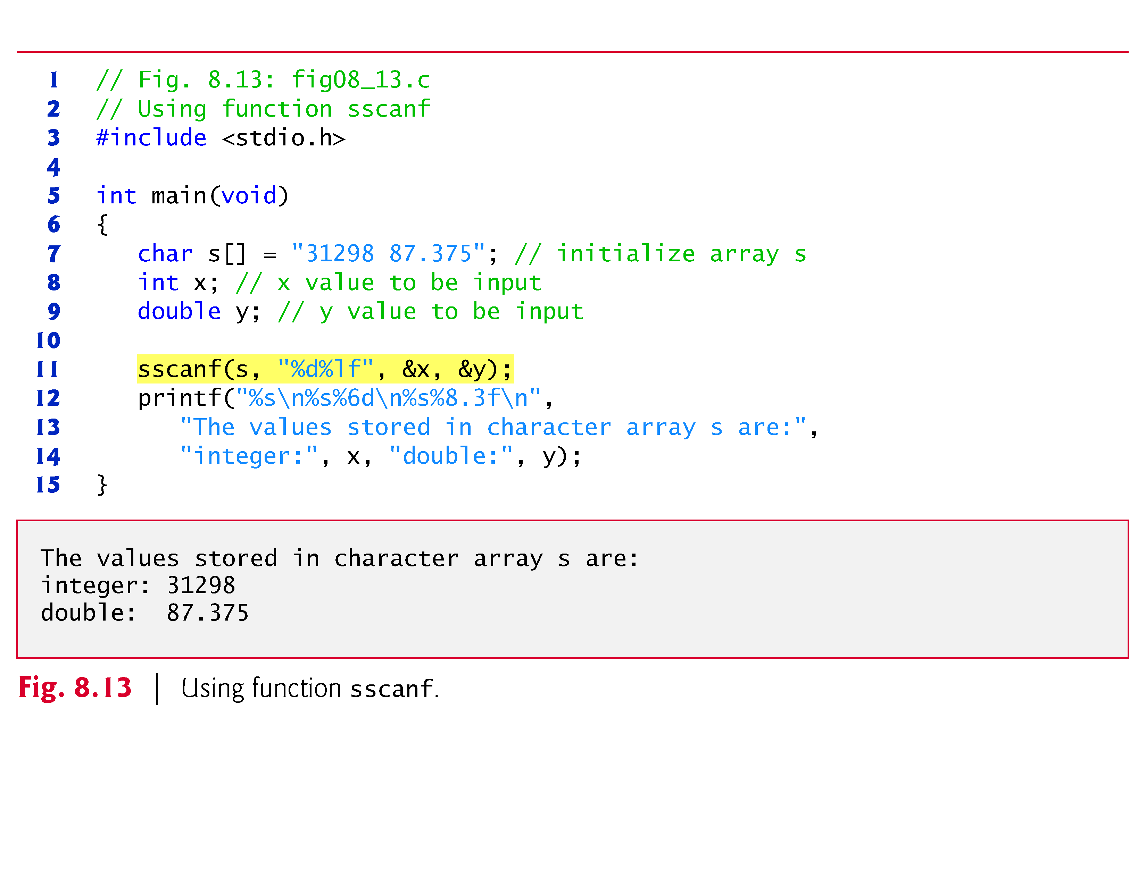
8.5.4 Function sscanf
Figure 8.13 uses function sscanf to read formatted data from character array s.
The function uses the same conversion specifiers as scanf.
The program reads an int and a double from array s and stores the values in x and y, respectively.
The values of x and y are printed.
Array s is the first argument of sscanf.

Slide 57
8.6 String-Manipulation Functions of the String-Handling Library
The string-handling library (<string.h>) provides many useful functions for
manipulating string data (copying and concatenating),
comparing strings,
searching strings for characters and other strings,
tokenizing strings (separating strings into logical pieces)
and determining the length of strings.
This section presents the string-manipulation functions of the string-handling library.
The functions are summarized in Fig. 8.17.
Every function—except for strncpy—appends the null character to its result.

Slide 58
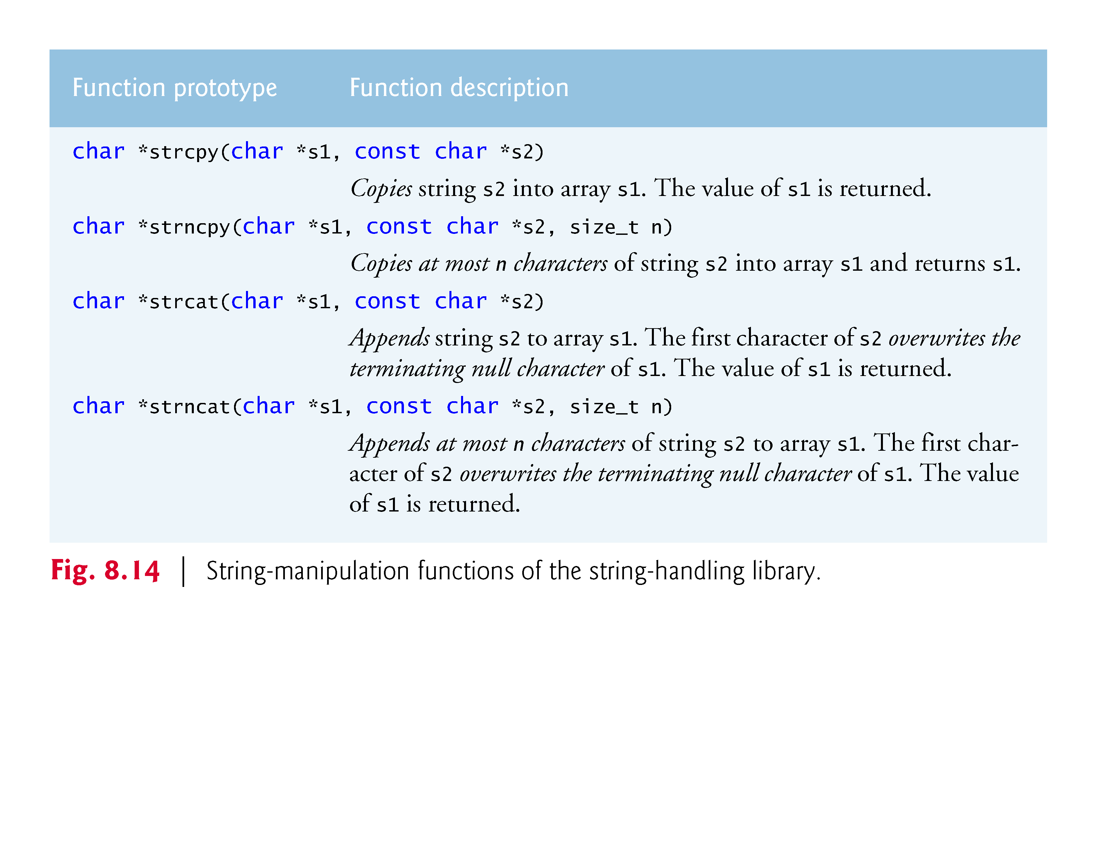

Slide 59
8.6 String-Manipulation Functions of the String-Handling Library (Cont.)
Functions strncpy and strncat specify a parameter of type size_t, which is a type defined by the C standard as the integral type of the value returned by operator sizeof.
Function strcpy copies its second argument (a string) into its first argument;
a character array that you must ensure is large enough to store the string and its terminating null character, which is also copied.

Slide 60
8.6 String-Manipulation Functions of the String-Handling Library (Cont.)
Function strncpy is equivalent to strcpy, except that
strncpy specifies the number of characters to be copied from the string into the array.
Function strncpy does not necessarily copy the terminating null character of its second argument.
This occurs only if the number of characters to be copied is at least one more than the length of the string.

Slide 61
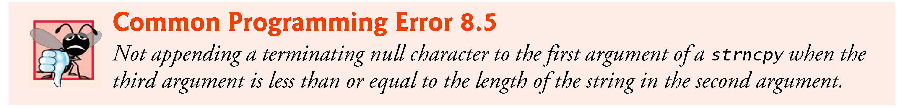
8.6 String-Manipulation Functions of the String-Handling Library (Cont.)
For example, if "test" is the second argument, a terminating null character is written only if the third argument to strncpy is at least 5 (four characters in "test" plus a terminating null character).
If the third argument is larger than 5, null characters are appended to the array until the total number of characters specified by the third argument are written.

Slide 62
8.6.1 Functions strcpy and strncpy
Figure 8.15 uses strcpy to copy the entire string in array x into array y and uses strncpy to copy the first 14 characters of array x into array z.
A null character ('\0') is appended to array z, because the call to strncpy in the program does not write a terminating null character (the third argument is less than the string length of the second argument).

Slide 63
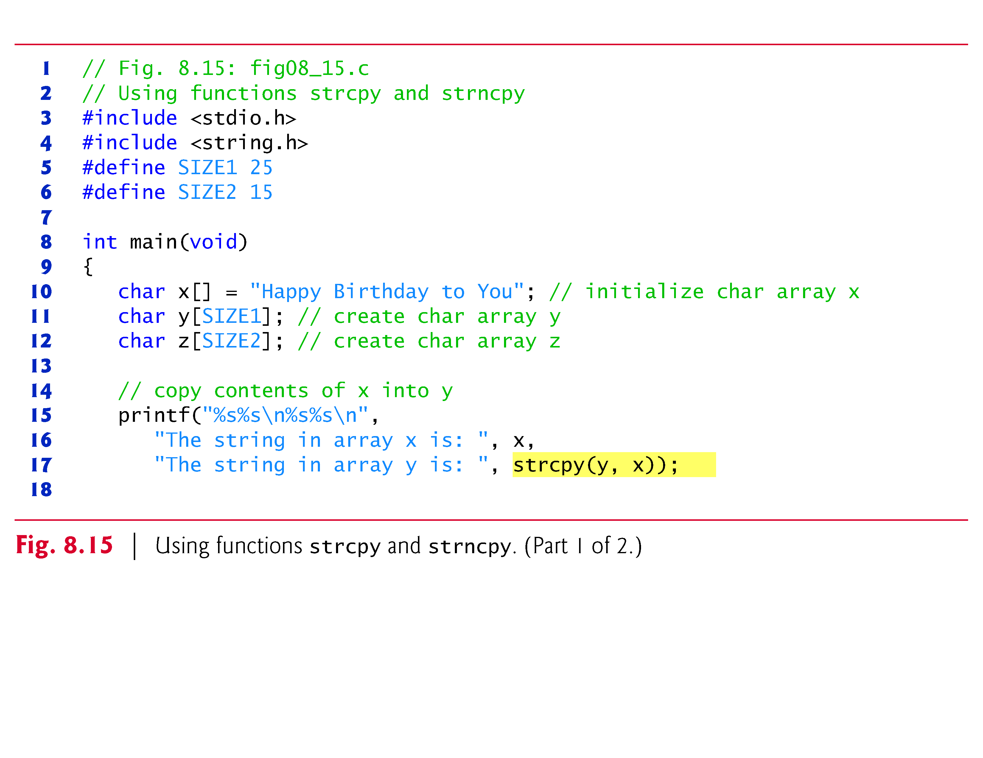

Slide 64
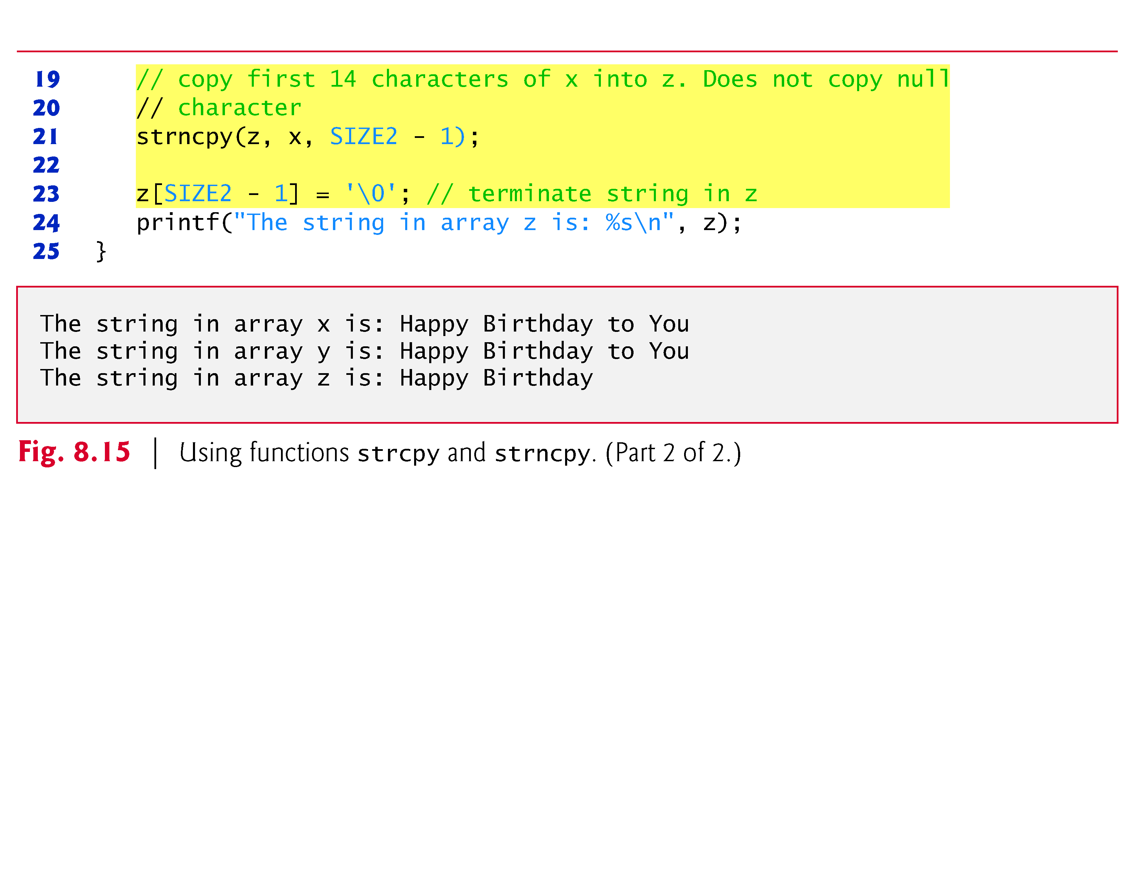

Slide 65
8.6.2 Functions strcat and strncat
Function strcat appends its second argument (a string) to its first argument (a character array containing a string).
The first character of the second argument replaces the null ('\0') that terminates the string in the first argument.
You must ensure that the array used to store the first string is large enough to store the first string, the second string and the terminating null character copied from the second string.
Function strncat appends a specified number of characters from the second string to the first string.
A terminating null character is appended to the result.
Figure 8.16 demonstrates functions strcat and strncat.

Slide 66
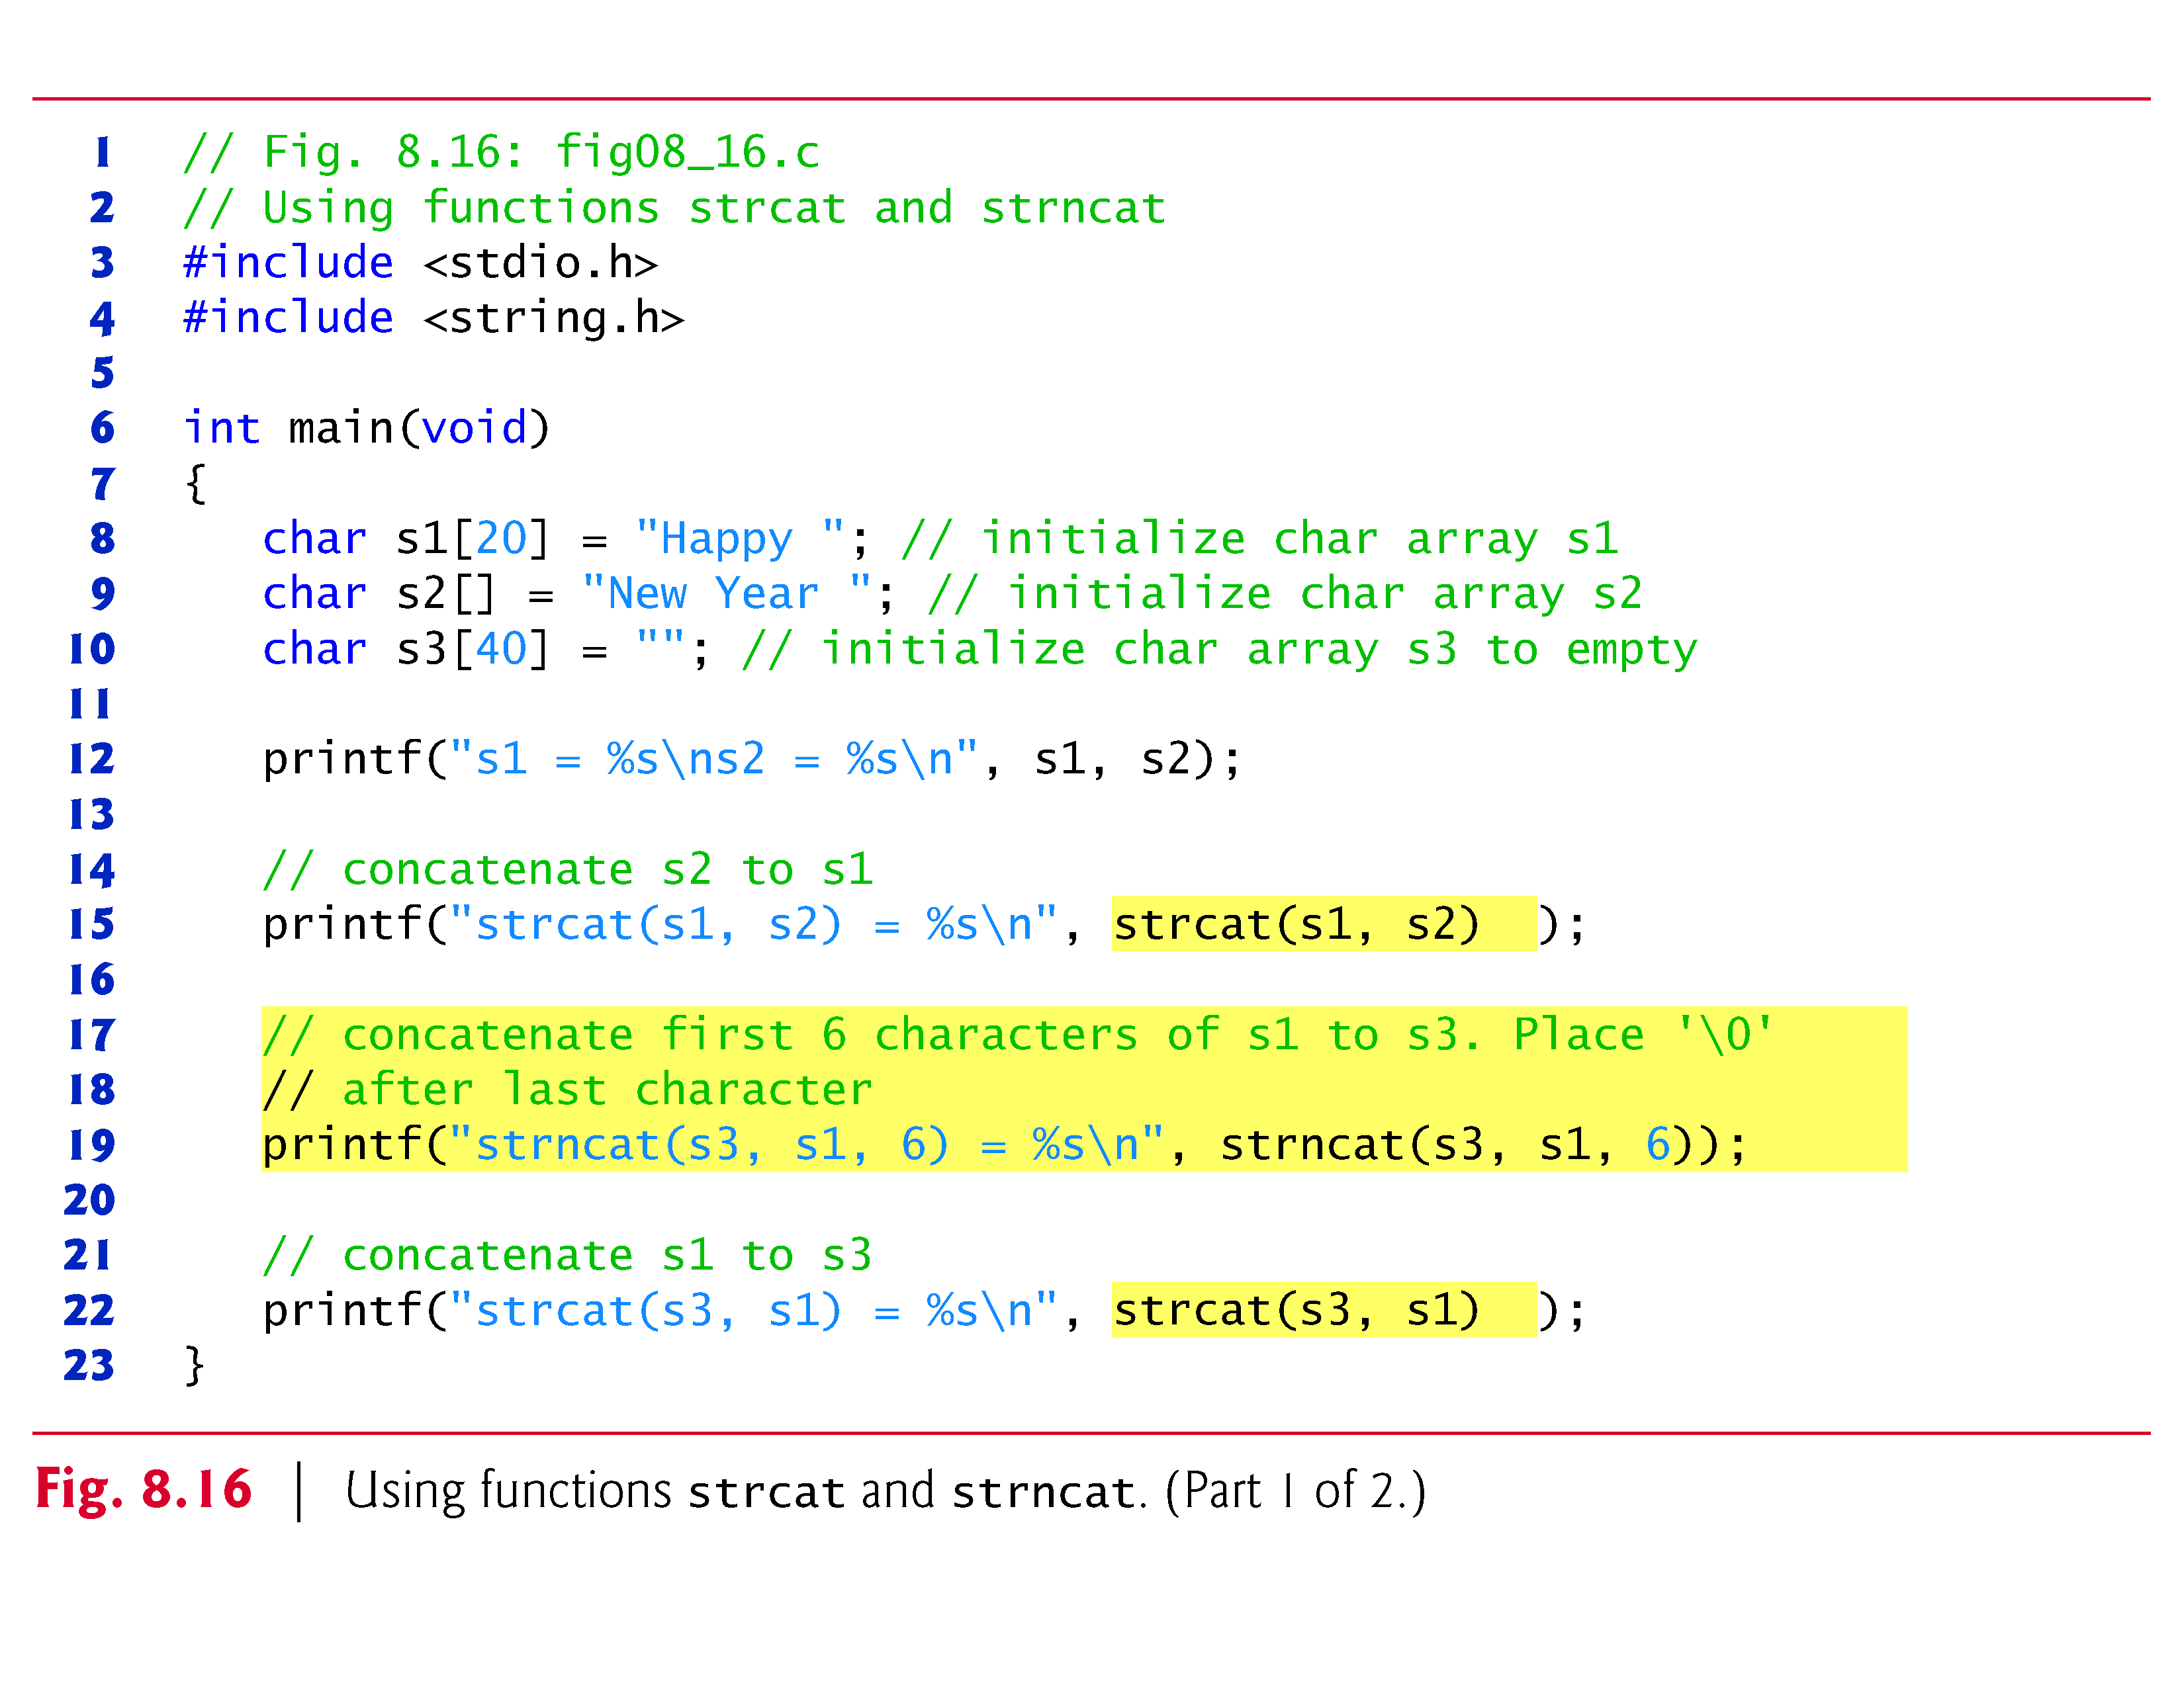

Slide 67
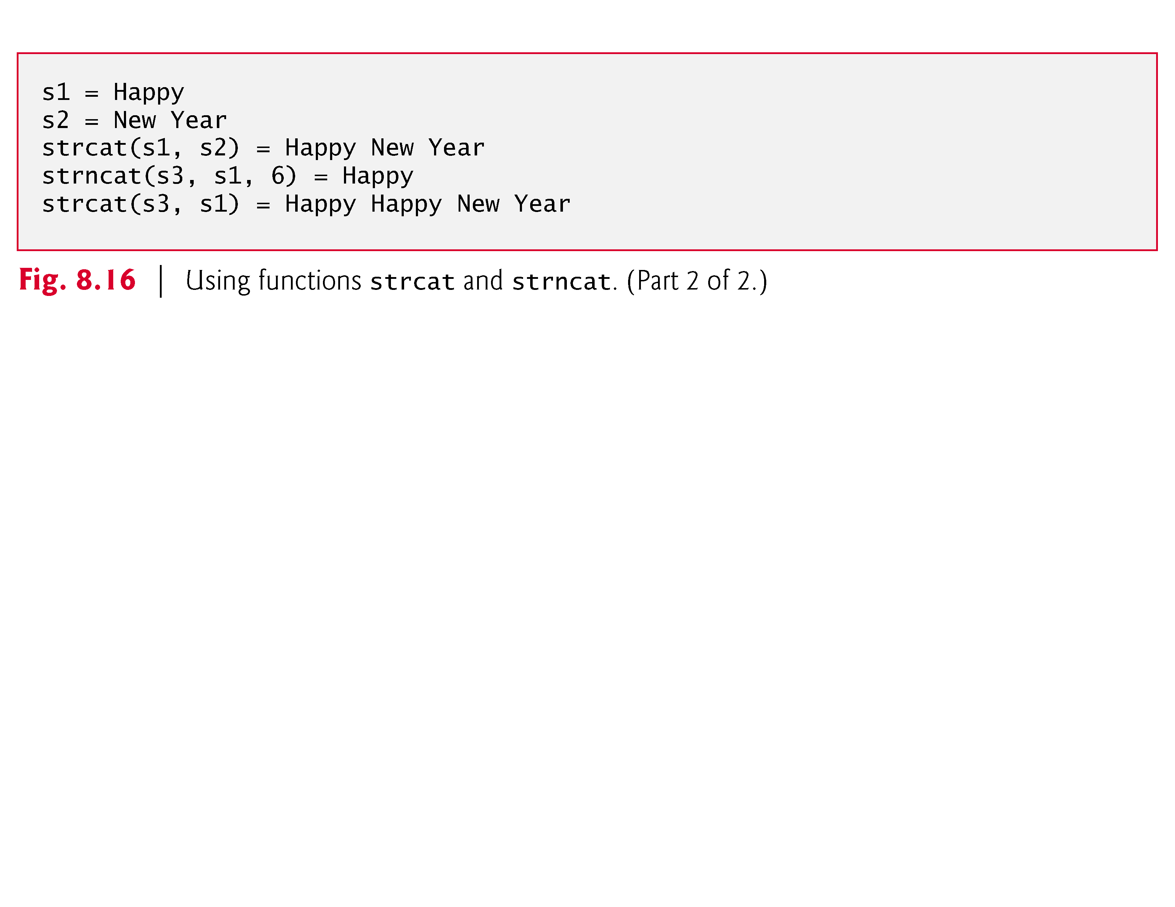

Slide 68
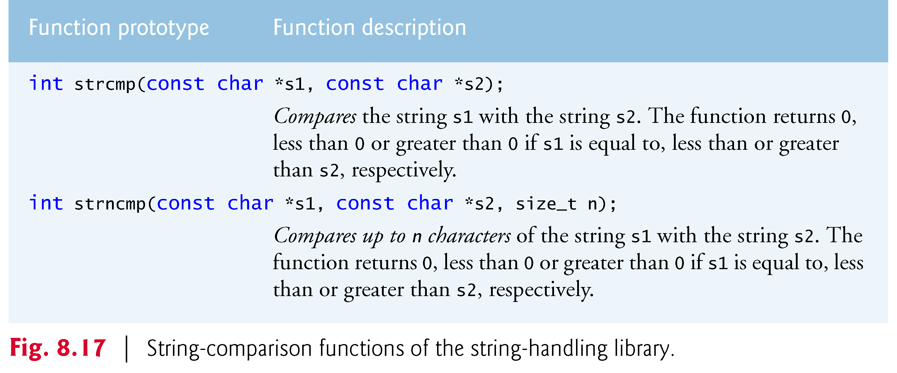
8.7 Comparison Functions of the String-Handling Library
This section presents the string-handling library’s string-comparison functions: strcmp and strncmp.
Fig. 8.17 contains their prototypes and a brief description of each function.

Slide 69
8.7 Comparison Functions of the String-Handling Library (Cont.)
Figure 8.18 compares three strings using strcmp and strncmp.
Function strcmp compares its first string argument with its second string argument, character by character.
The function returns
0 if the strings are equal,
a negative value if the first string is less than the second string
and a positive value if the first string is greater than the second string.
Function strncmp is equivalent to strcmp, except that strncmp compares up to a specified number of characters.
Function strncmp does not compare characters following a null character in a string.
The program prints the integer value returned by each function call.

Slide 70
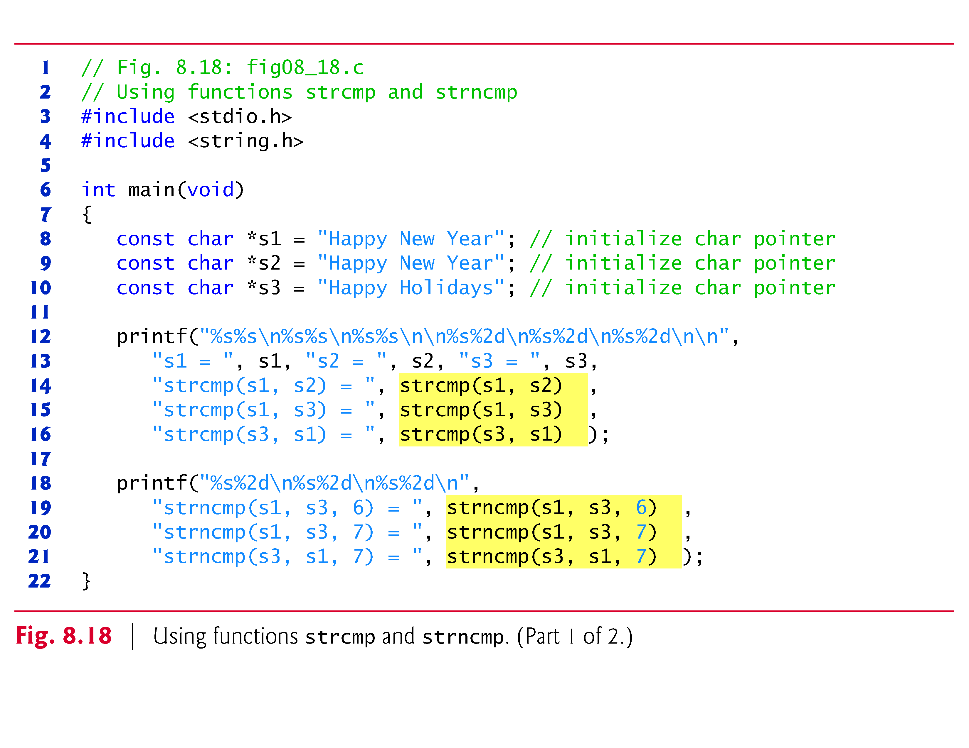

Slide 71
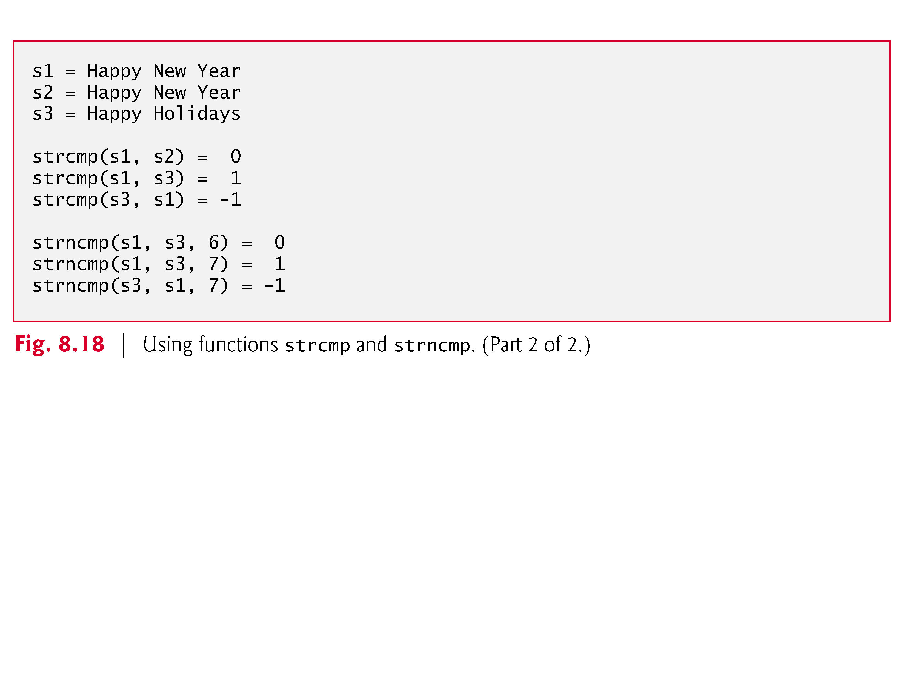
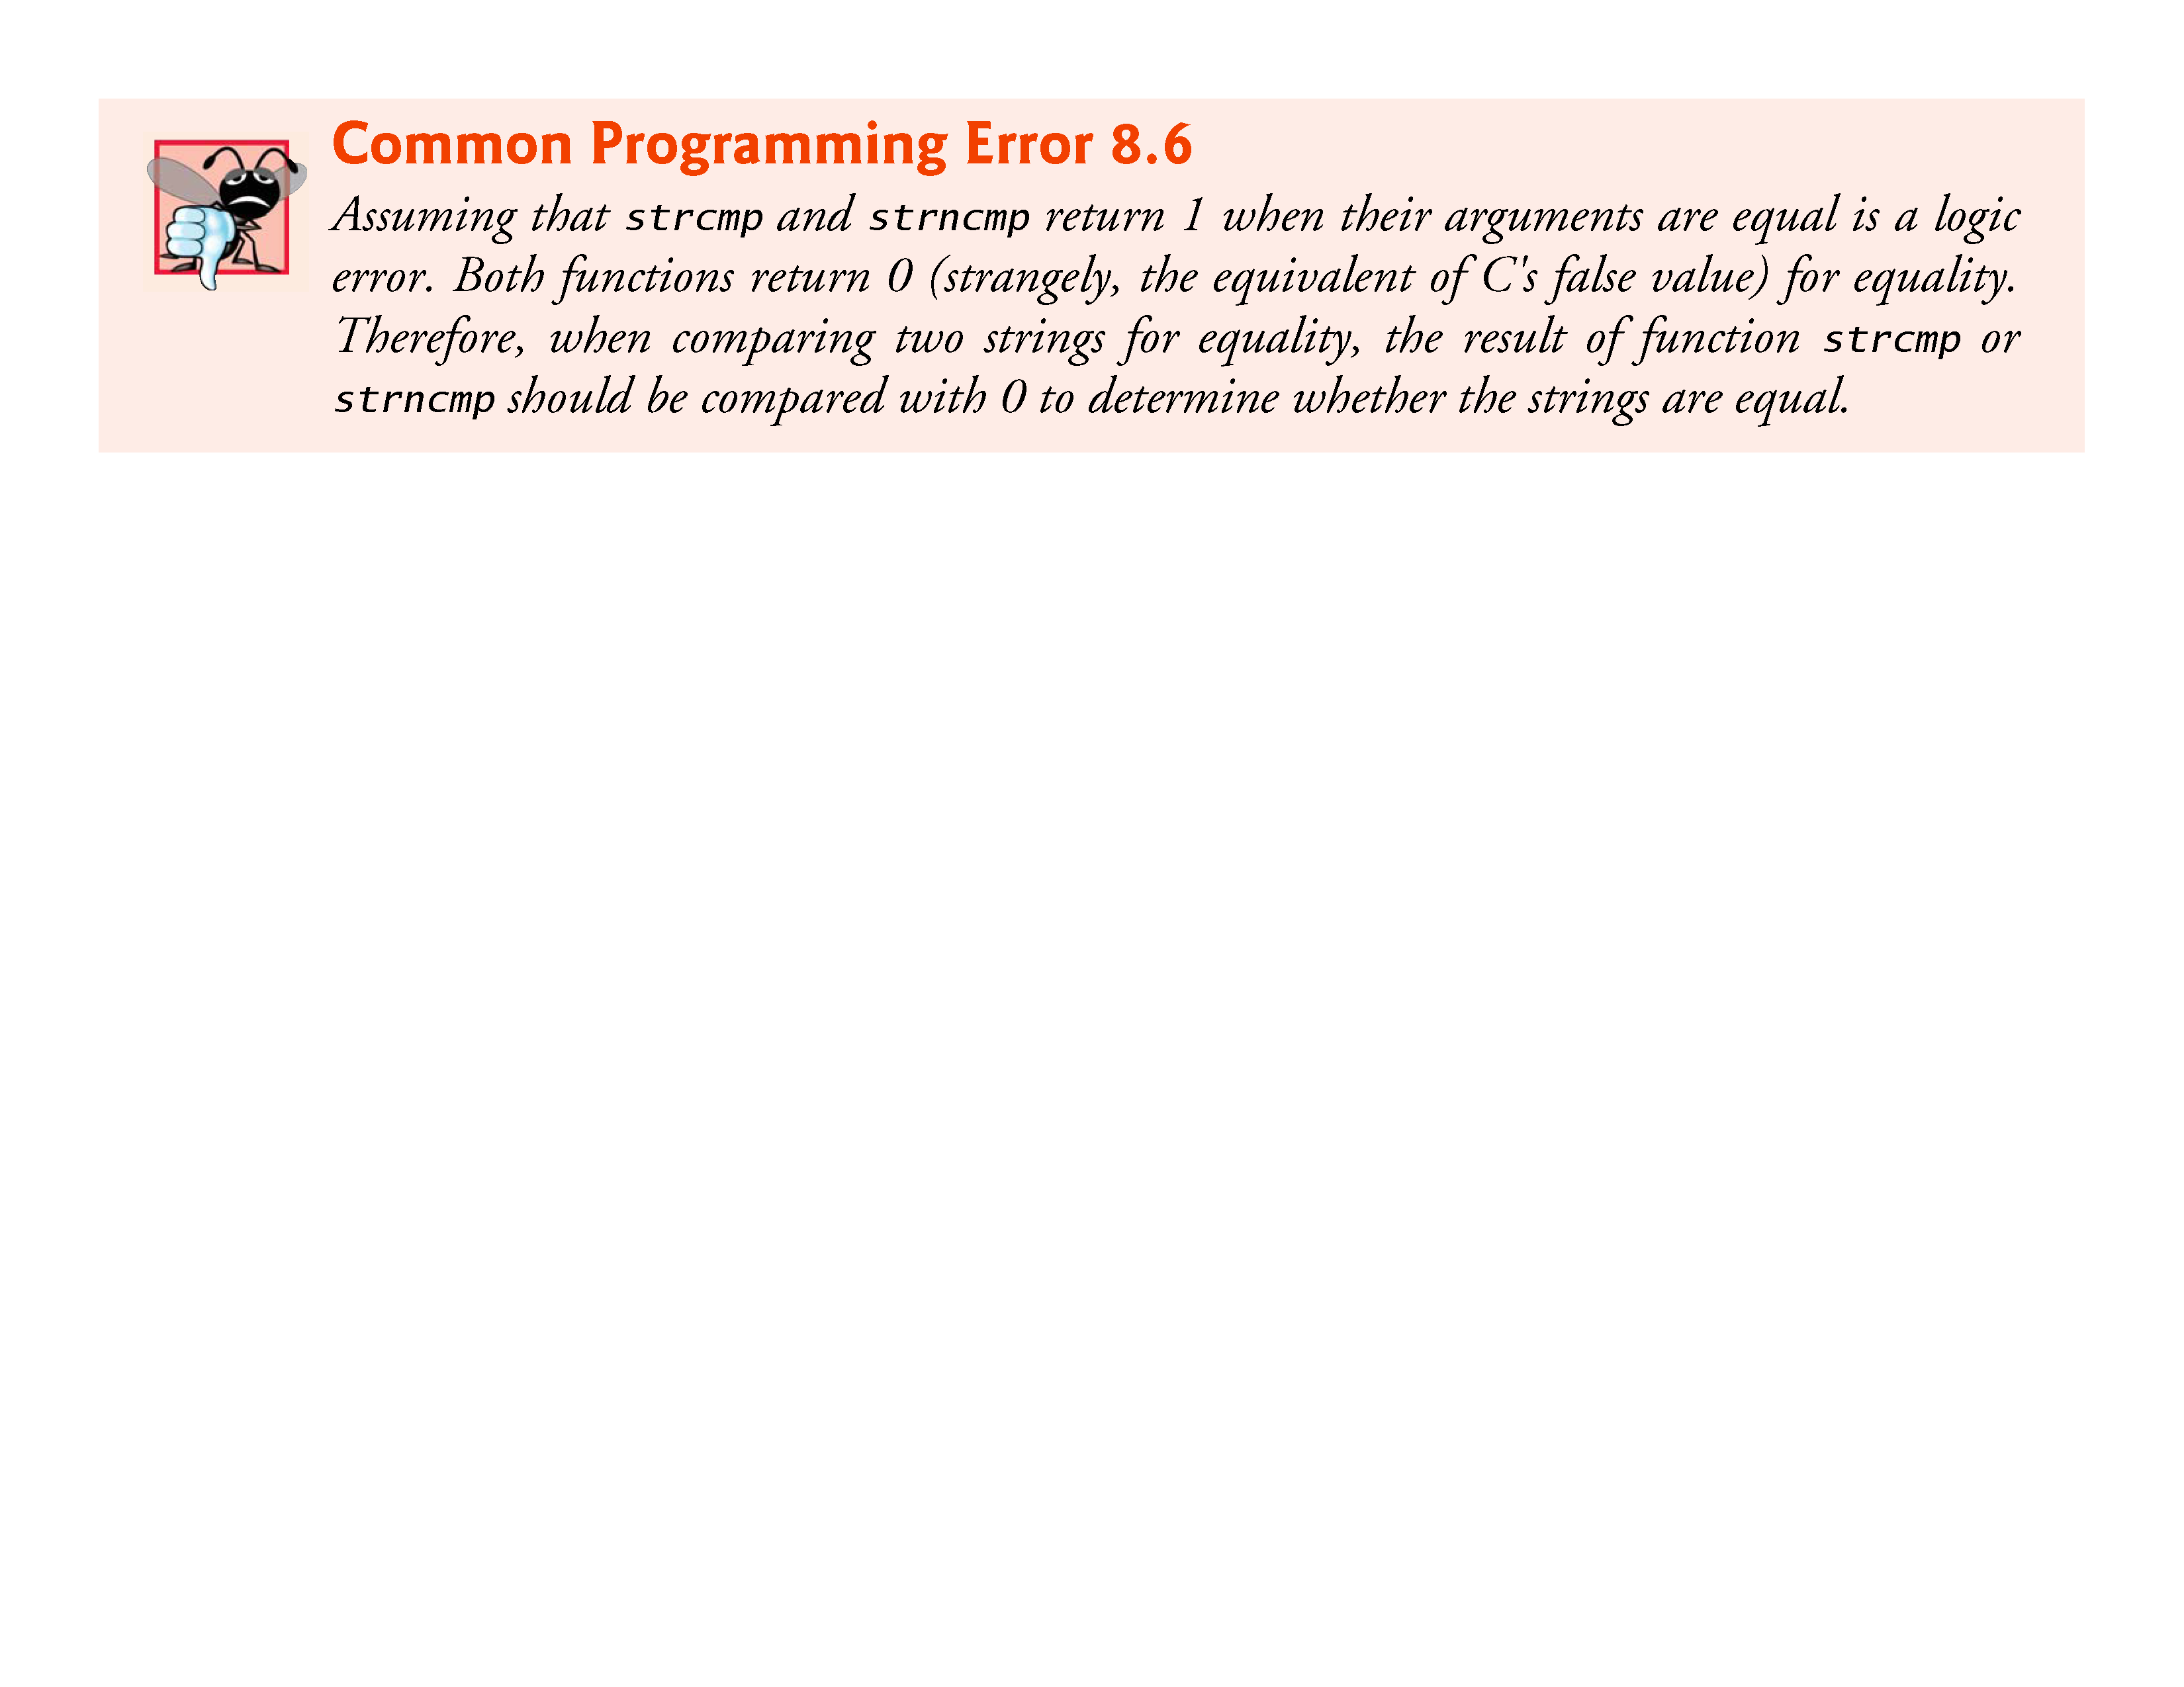

Slide 72
8.7 Comparison Functions of the String-Handling Library (Cont.)
To understand just what it means for one string to be “greater than” or “less than” another, consider the process of alphabetizing a series of last names.
We would place “Jones” before “Smith,” because the first letter of “Jones” comes before the first letter of “Smith” in the alphabet.
But the alphabet is more than just a list of 26 letters—it’s an ordered list of characters.
Each letter occurs in a specific position within the list.

Slide 73
8.7 Comparison Functions of the String-Handling Library (Cont.)
“Z” is more than merely a letter of the alphabet; “Z” is specifically the 26th letter of the alphabet.
How do the string comparison functions know that one particular letter comes before another?
All characters are represented inside the computer as numeric codes in character sets such as ASCII and Unicode;
when the computer compares two strings, it actually compares the numeric codes of the characters in the strings.
This section presents the functions of the string-handling library used to search strings for characters and other strings.
The functions are summarized in Fig. 8.19.
The functions strcspn and strspn return size_t.

Slide 74
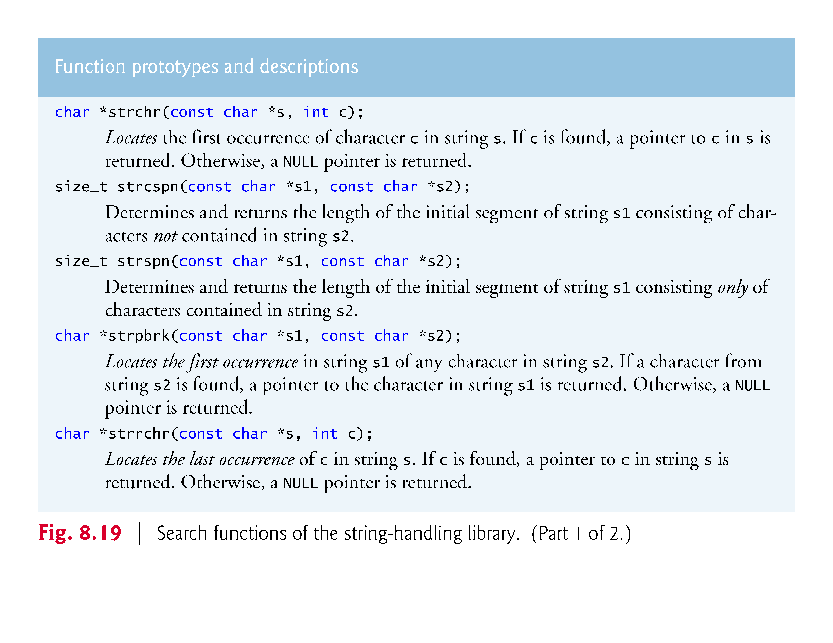

Slide 75
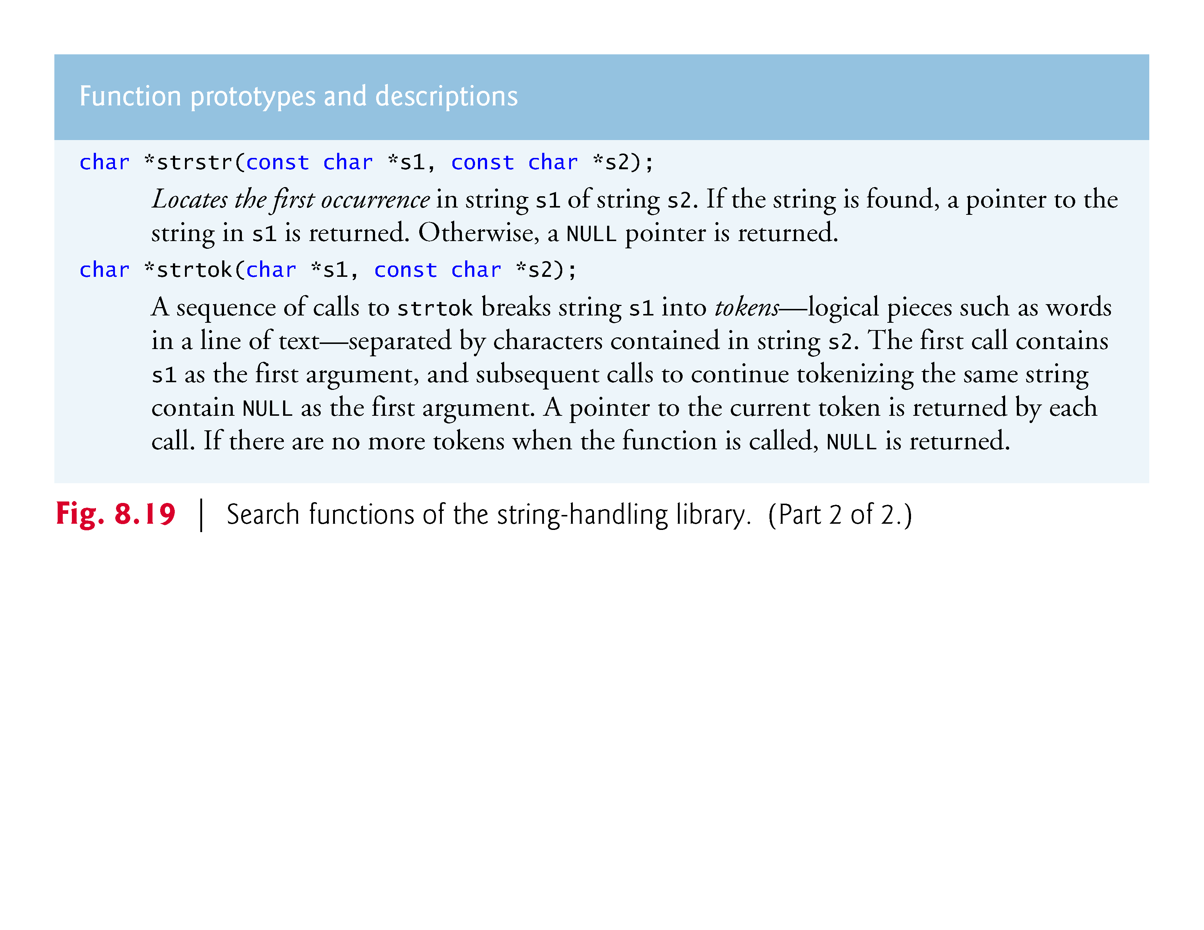

Slide 76
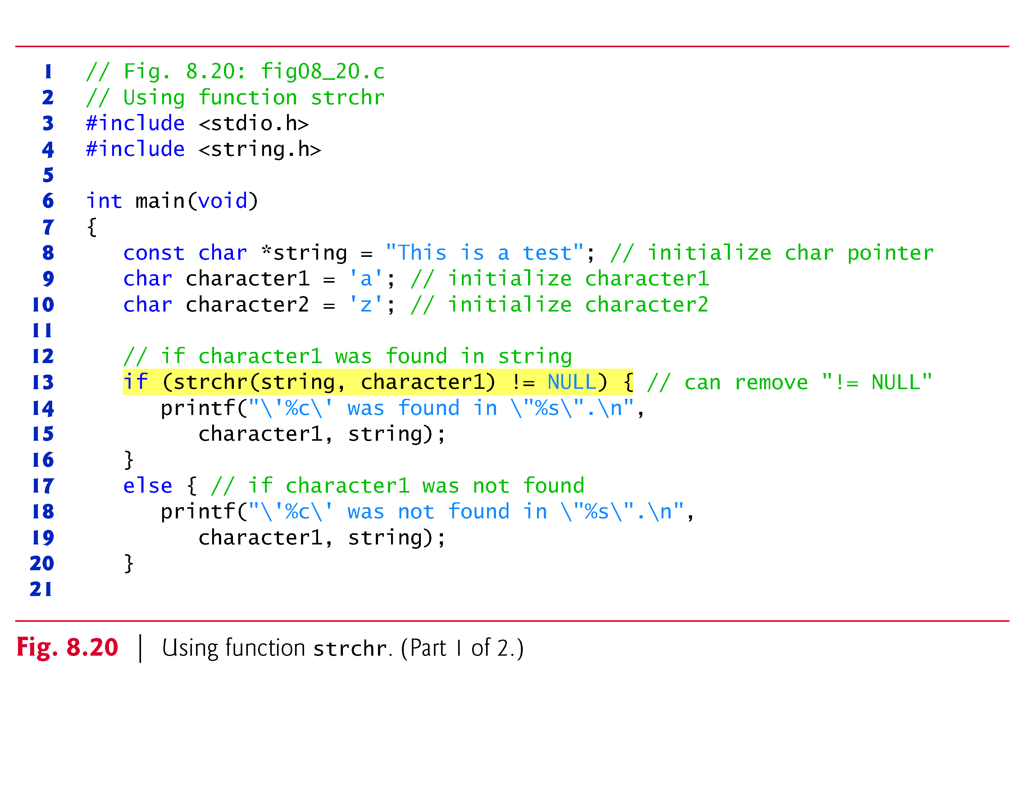
8.8.1 Function strchr
Function strchr searches for the first occurrence of a character in a string.
If the character is found, strchr returns a pointer to the character in the string; otherwise, strchr returns NULL.
Figure 8.20 searches for the first occurrences of 'a' and 'z' in "This is a test".

Slide 78
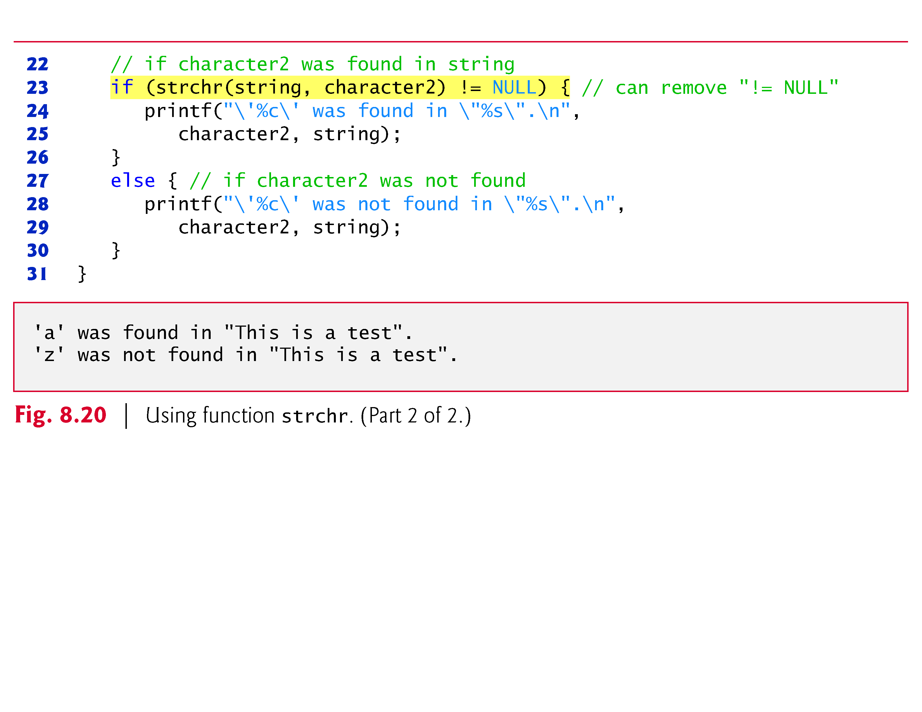

Slide 79
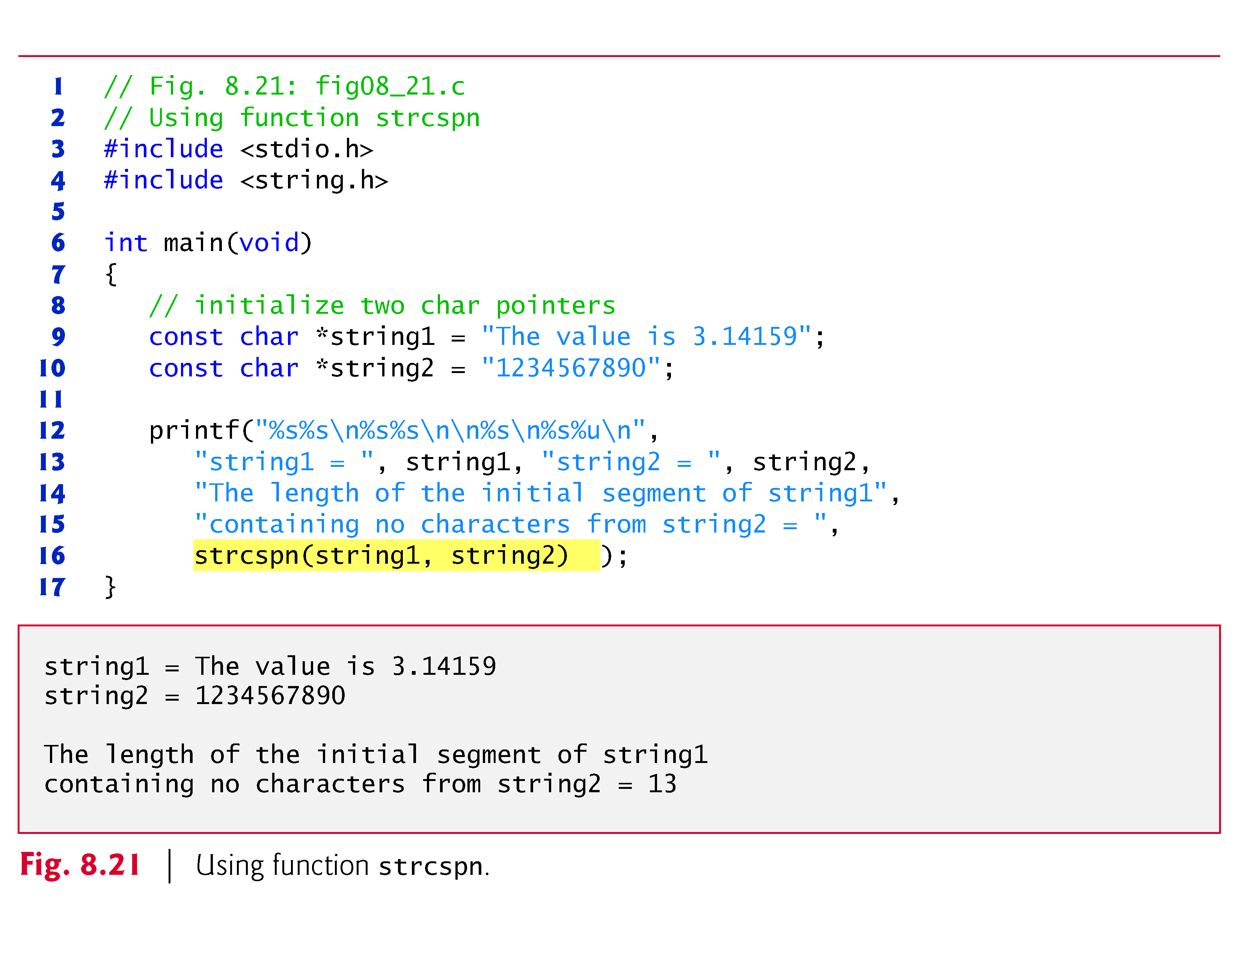
8.8.2 Function strcspn
Function strcspn (Fig. 8.21) determines the length of the initial part of the string in its first argument that does not contain any characters from the string in its second argument.
The function returns the length of the segment.

Slide 81
8.8.3 Function strpbrk
Function strpbrk searches its first string argument for the first occurrence of any character in its second string argument.
If a character from the second argument is found, strpbrk returns a pointer to the character in the first argument; otherwise, strpbrk returns NULL.
Figure 8.22 shows a program that locates the first occurrence in string1 of any character from string2.

Slide 82
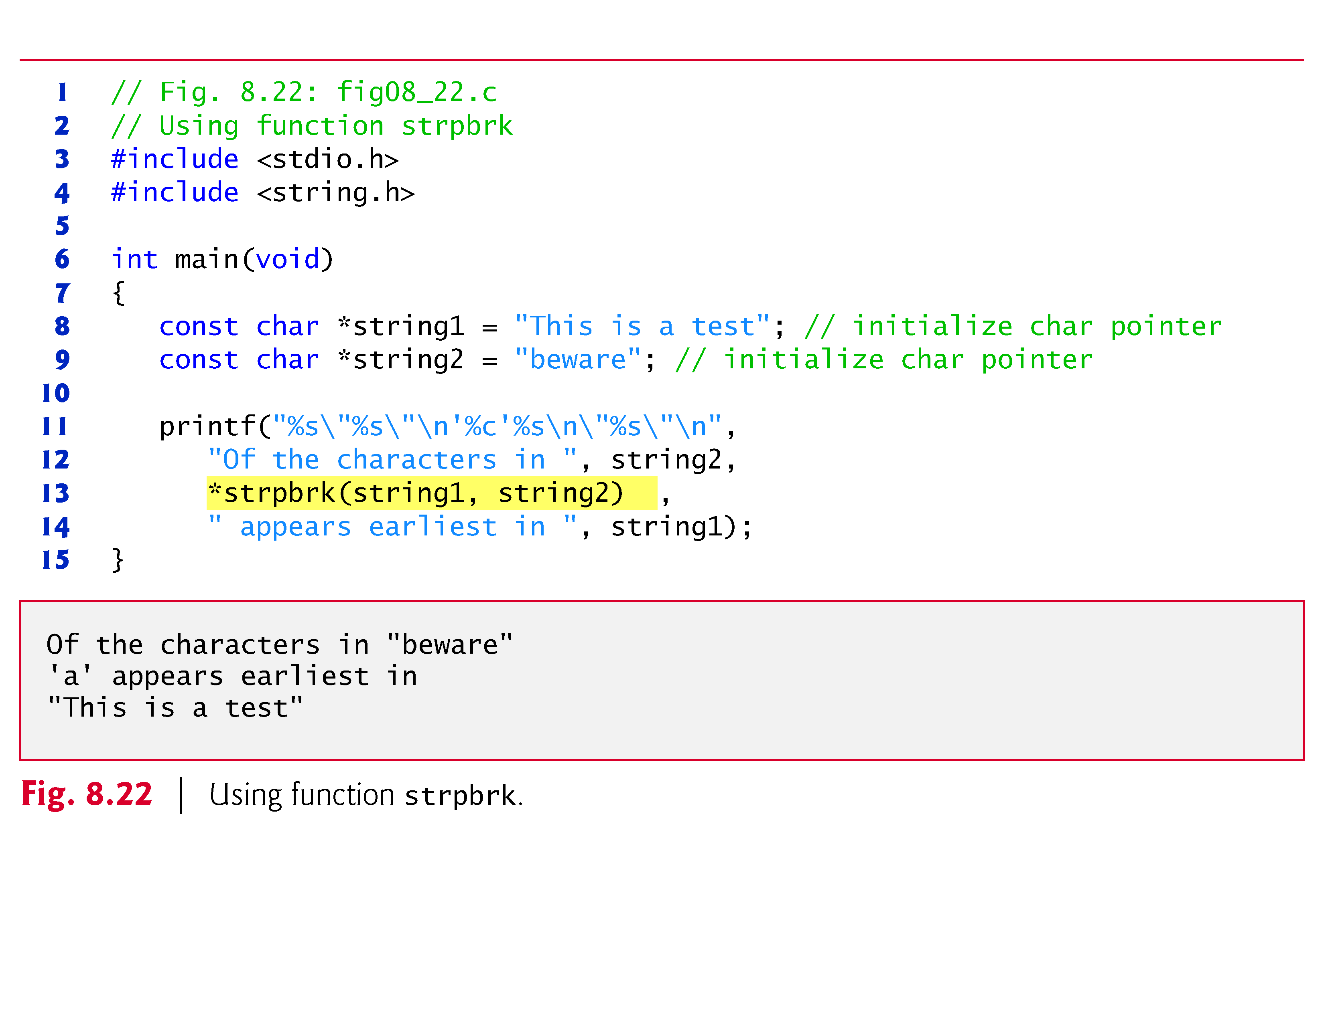

Slide 83
8.8.4 Function strrchr
Function strrchr searches for the last occurrence of the specified character in a string.
If the character is found, strrchr returns a pointer to the character in the string; otherwise, strrchr returns NULL.
Figure 8.23 shows a program that searches for the last occurrence of the character 'z' in the string "A zoo has many animals including zebras."

Slide 84
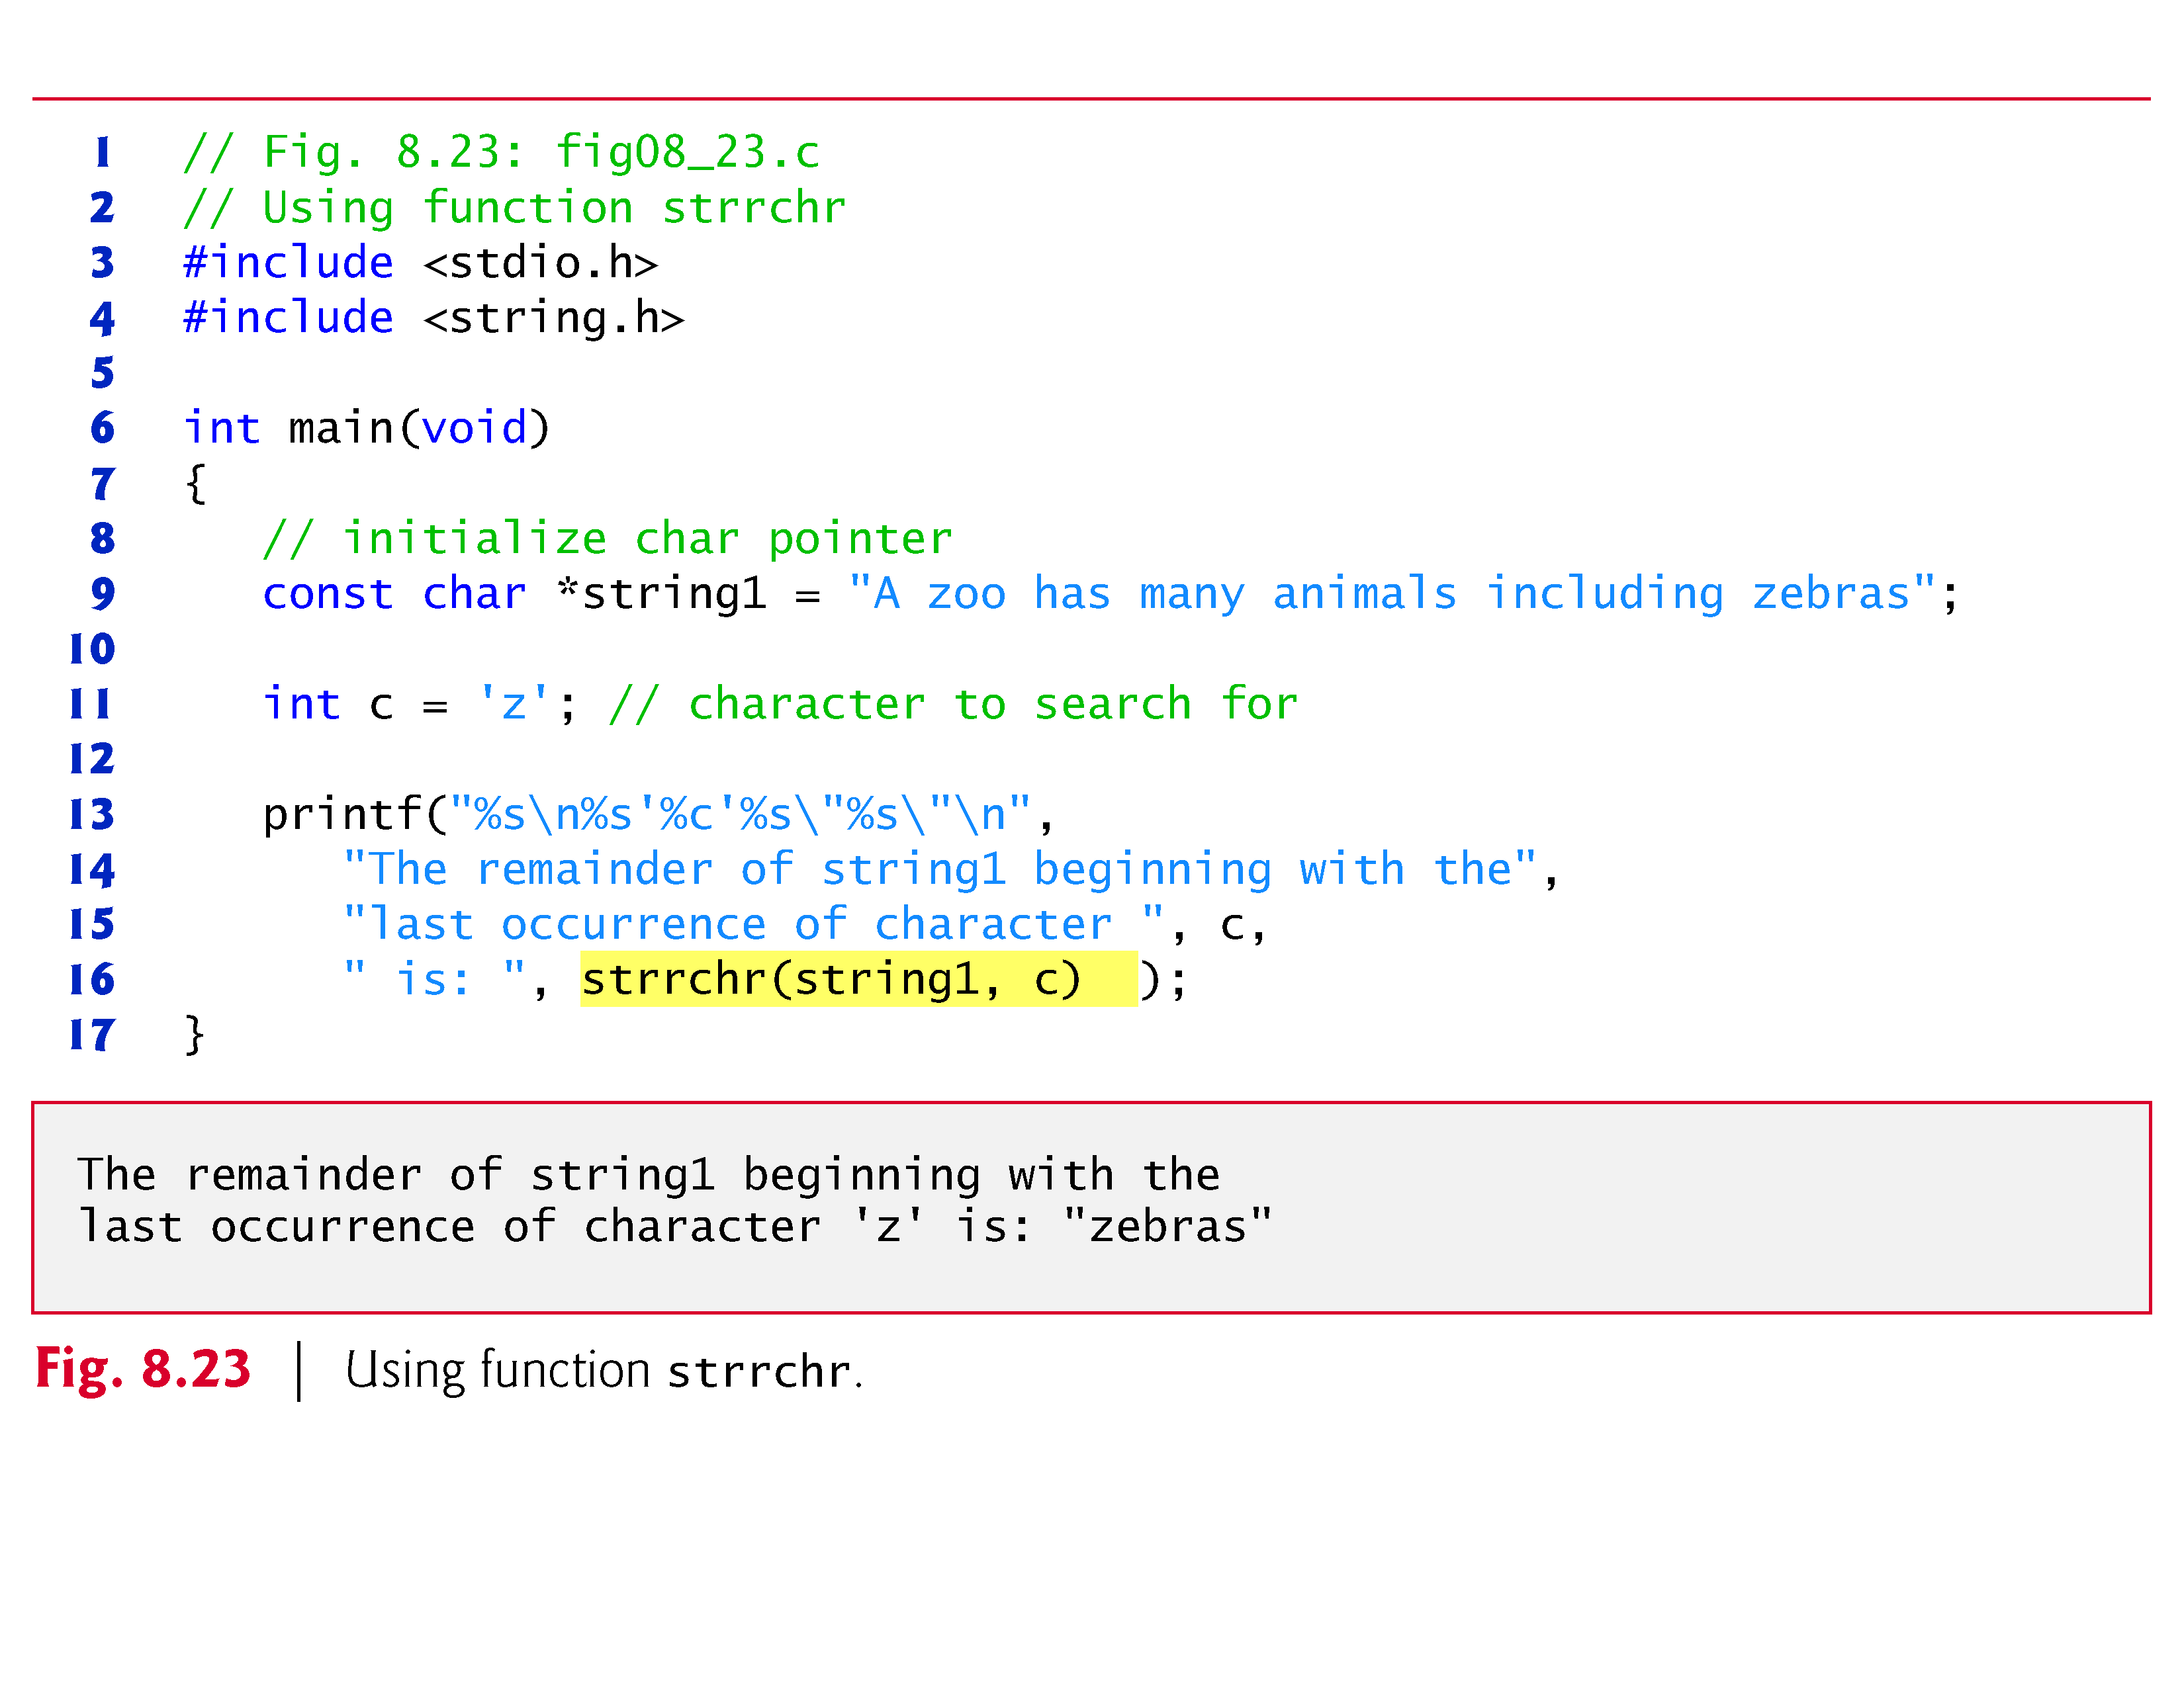

Slide 85
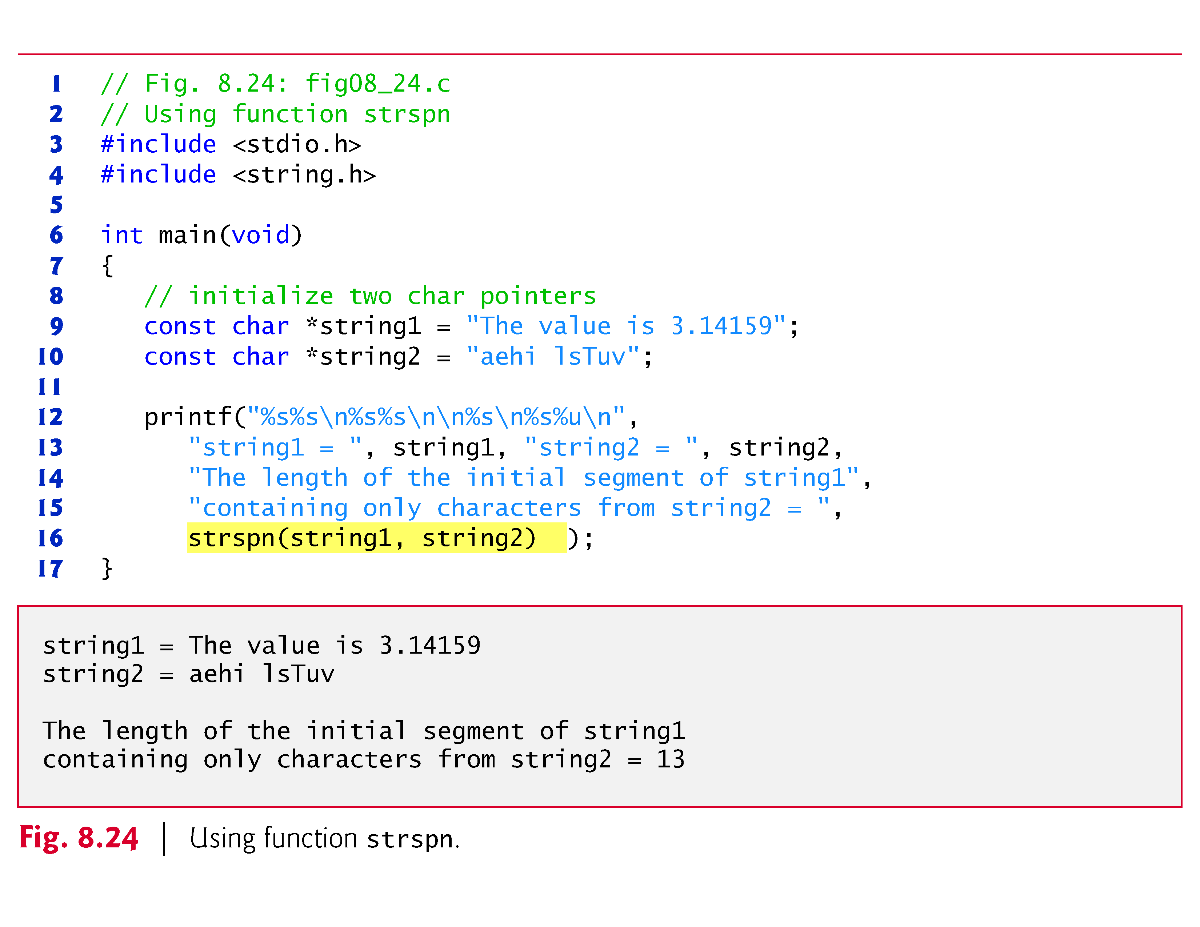
8.8.5 Function strspn
Function strspn (Fig. 8.24) determines the length of the initial part of the string in its first argument that contains only characters from the string in its second argument.
The function returns the length of the segment.

Slide 87
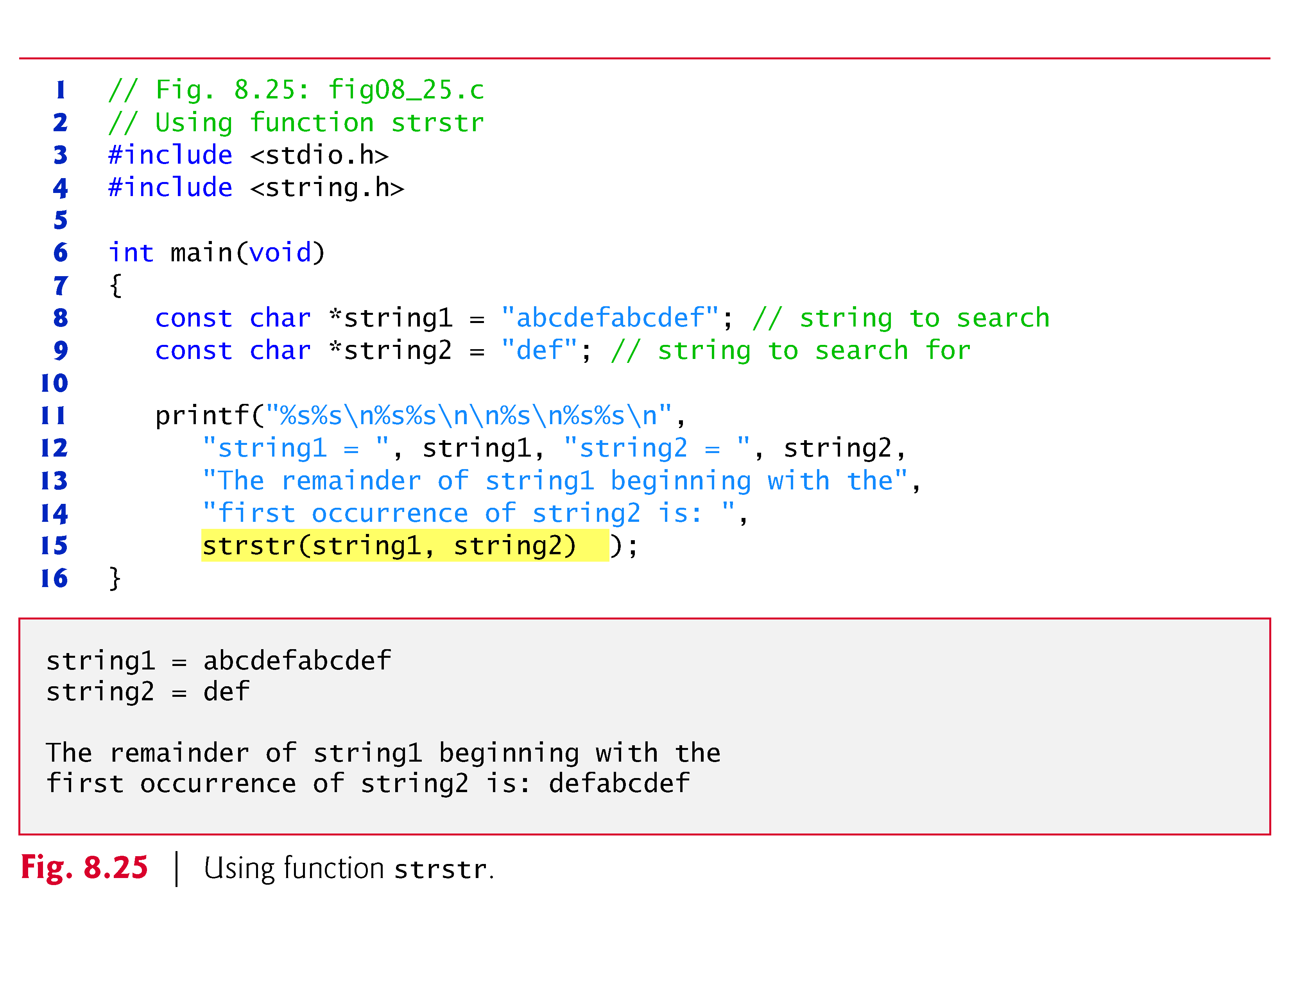
8.8.6 Function strstr
Function strstr searches for the first occurrence of its second string argument in its first string argument.
If the second string is found in the first string, a pointer to the location of the string in the first argument is returned.
Figure 8.25 uses strstr to find the string "def" in the string "abcdefabcdef".

Slide 89
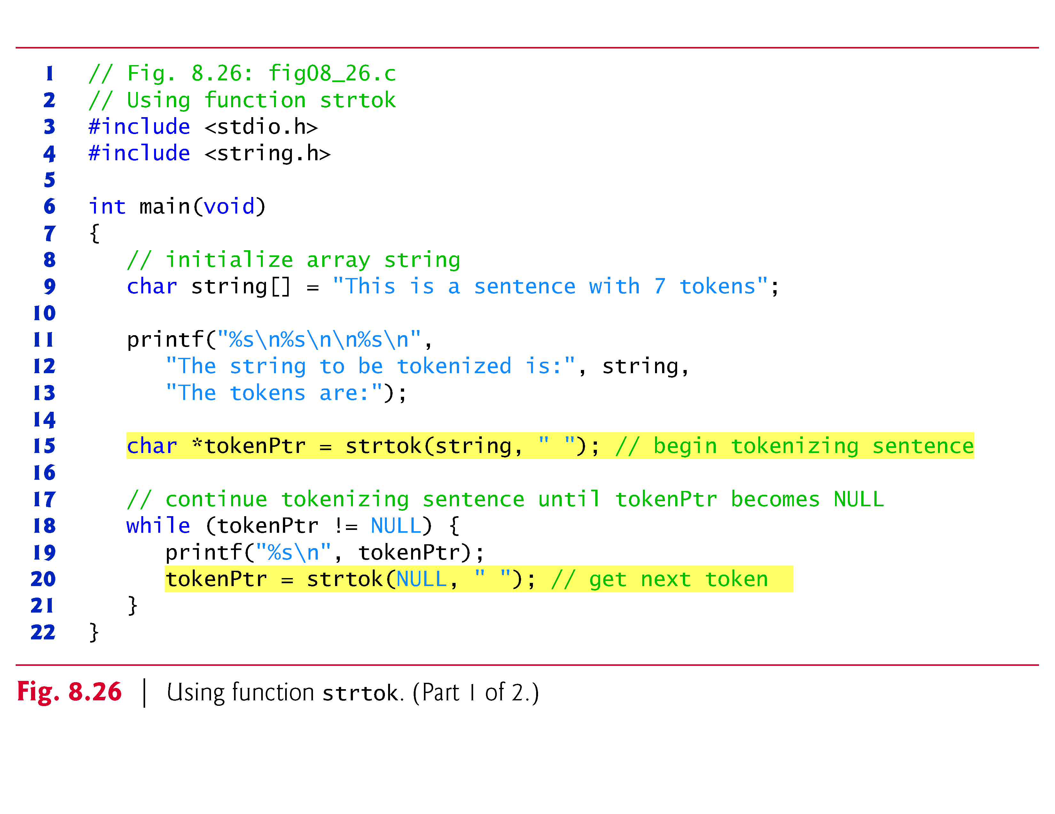
8.8.7 Function strtok
Function strtok (Fig. 8.26) is used to break a string into a series of tokens.
A token is a sequence of characters separated by delimiters (usually spaces or punctuation marks, but a delimiter can be any character).
For example, in a line of text, each word can be considered a token, and the spaces and punctuation separating the words can be considered delimiters.

Slide 91


Slide 92
8.8.7 Function strtok (Cont.)
Multiple calls to strtok are required to tokenize a string:
i.e., break it into tokens (assuming that the string contains more than one token).
The first call to strtok contains two arguments:
a string to be tokenized,
and a string containing characters that separate the tokens.
The statement
// begin tokenizing sentence tokenPtr = strtok(string, " ");
assigns tokenPtr a pointer to the first token in string.

Slide 93
8.8.7 Function strtok (Cont.)
The second argument, " ", indicates that tokens are separated by spaces.
Function strtok searches for the first character in string that’s not a delimiting character (space).
This begins the first token.
The function then finds the next delimiting character in the string and replaces it with a null ('\0') character to terminate the current token.
Function strtok saves a pointer to the next character following the token in string and returns a pointer to the current token.

Slide 94
8.8.7 Function strtok (Cont.)
Subsequent strtok calls continue tokenizing string.
These calls contain NULL as their first argument.
The NULL argument indicates that the call to strtok should continue tokenizing from the location in string saved by the last call to strtok.
If no tokens remain when strtok is called, strtok returns NULL.

Slide 95
8.8.7 Function strtok (Cont.)
You can change the delimiter string in each new call to strtok.
Figure 8.26 uses strtok to tokenize the string "This is a sentence with 7 tokens".
Each token is printed separately.
Function strtok modifies the input string by placing '\0' at the end of each token;
therefore, a copy of the string should be made if the string will be used again in the program after the calls to strtok.

Slide 96
8.9 Memory Functions of the String-Handling Library
The string-handling library functions presented in this section manipulate, compare and search blocks of memory.
The functions treat blocks of memory as character arrays and can manipulate any block of data.
Figure 8.27 summarizes the memory functions of the string-handling library.
In the function discussions, “object” refers to a block of data.

Slide 97


Slide 98


Slide 99
8.9 Memory Functions of the String-Handling Library (Cont.)
The pointer parameters are declared void * so they can manipulate memory for any data type.
In Chapter 7, we saw that
a pointer to any data type can be assigned directly to a pointer of type void *,
and a pointer of type void * can be assigned directly to a pointer to any data type.
So, these functions can receive pointers to any data type.
Because a void * pointer cannot be dereferenced, each function receives a size argument that specifies the number of characters (bytes) the function will process.
For simplicity, the examples in this section manipulate character arrays (blocks of characters).

Slide 100

8.9.1 Function memcpy
Function memcpy copies a specified number of characters from the object pointed to by its second argument into the object pointed to by its first argument.
The function can receive a pointer to any type of object.
The result of this function is undefined if the two objects overlap in memory (i.e., if they are parts of the same object)—in such cases, use memmove.
Figure 8.31 uses memcpy to copy the string in array s2 to array s1.

Slide 101


Slide 102

8.9.2 Function memmove
Function memmove, like memcpy, copies a specified number of bytes from the object pointed to by its second argument into the object pointed to by its first argument.
Copying is performed as if
the bytes were copied from the second argument into a temporary character array,
then copied from the temporary array into the first argument.
This allows characters from one part of a string to be copied into another part of the same string.
Figure 8.29 uses memmove to copy the last 10 bytes of array x into the first 10 bytes of array x.

Slide 103


Slide 104
8.9.3 Function memcmp
Function memcmp (Fig. 8.30) compares the specified number of characters of its first argument with the corresponding characters of its second argument.
The function;
returns a value greater than 0 if the first argument is greater than the second,
returns 0 if the arguments are equal
and returns a value less than 0 if the first argument is less than the second.

Slide 105


Slide 106

8.9.4 Function memchr
Function memchr searches for the first occurrence of a byte, represented as unsigned char, in the specified number of bytes of an object.
If the byte is found, a pointer to the byte in the object is returned; otherwise, a NULL pointer is returned.
Figure 8.31 searches for the character (byte) 'r' in the string "This is a string".

Slide 108

8.9.5 Function memset
Function memset copies the value of the byte in its second argument into the first n bytes of the object pointed to by its first argument, where n is specified by the third argument.
Figure 8.32 uses memset to copy 'b' into the first 7 bytes of string1.

Slide 109


Slide 110

8.10 Other Functions of the String-Handling Library
The two remaining functions of the string-handling library are strerror and strlen.
Figure 8.33 summarizes the strerror and strlen functions.

Slide 111

8.10.1 Function strerror
Function strerror takes an error number and creates an error message string.
A pointer to the string is returned.
Figure 8.34 demonstrates strerror.

Slide 112

8.10.2 Function strlen
Function strlen takes a string as an argument and returns the number of characters in the string—the terminating null character is not included in the length.
Figure 8.35 demonstrates function strlen.

Slide 113
8.11 Secure C Programming (Cont.)
Reading Numeric Inputs and Input Validation
It’s important to validate the data that you input into a program.
For example, when you ask the user to enter an integer in the range 1–100 then attempt to read that integer using scanf, there are several possible problems.
The user could enter an integer that’s outside the program’s required range, an integer that’s outside the allowed range for integers on that computer, a non-integer numeric value or a non-numeric value.

Slide 114
8.11 Secure C Programming (Cont.)
You can use various functions that you learned in this chapter to fully validate such input. For example, you could
use fgets to read the input as a line of text
convert the string to a number using strtol and ensure that the conversion was successful,
Then ensure that the value is in range.

